Slide 1
Introduction to Azure Managed Instances
Patrick Flynn

Slide 2

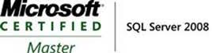


Patrick Flynn SQL Server DBA Link Group
MCM – SQL Server 2008
MCSM – Data Platform
Production DBA for 10+ years.
https://github.com/sqllensman/Presentations
patrick@sqllensman.com
@sqllensman
Patrick Flynn

Slide 3
Azure Relational Database Platform
Power BI
Azure App Services
Azure Data Factory
Azure Analysis Services
Azure Machine Learning
Azure Cognitive Services
Azure Bot Service
Azure SQL Database
SQL Data Warehouse
PostgreSQL
MySQL
MariaDB
Database Services Platform
Intelligent Advisors, tuning, monitoring
Flexible On-demand scaling, resource governance
Trusted HA/DR, backup/restore, security, audit, isolation
Azure compute
Azure storage
Global Azure in 54 regions

Slide 4
Benefits of Platform as a Service
Your work so far | How PaaS helps
Hardware purchasing and management | Built-in scale on-demand
Protect data with backups (with health checks and retention) | Built-in point-in-time restore
High availability implementation | Built-in 99.99% SLA and auto-failover
Disaster recovery implementation | Built-in geo-redundancy and geo-replication
Ensure compliance with standards on your own | Built-in easy to use features
Secure your data from malicious users and mistakes | Built-in easy to use features
Role out updates and upgrades | Built-in updates and upgrades
Monitor, troubleshoot, and manage at scale | Built-in easy to use features
Tune and maintain for predictable performance | Built-in easy to use features
We take care of your database chores
Notes:
1 min

Slide 5
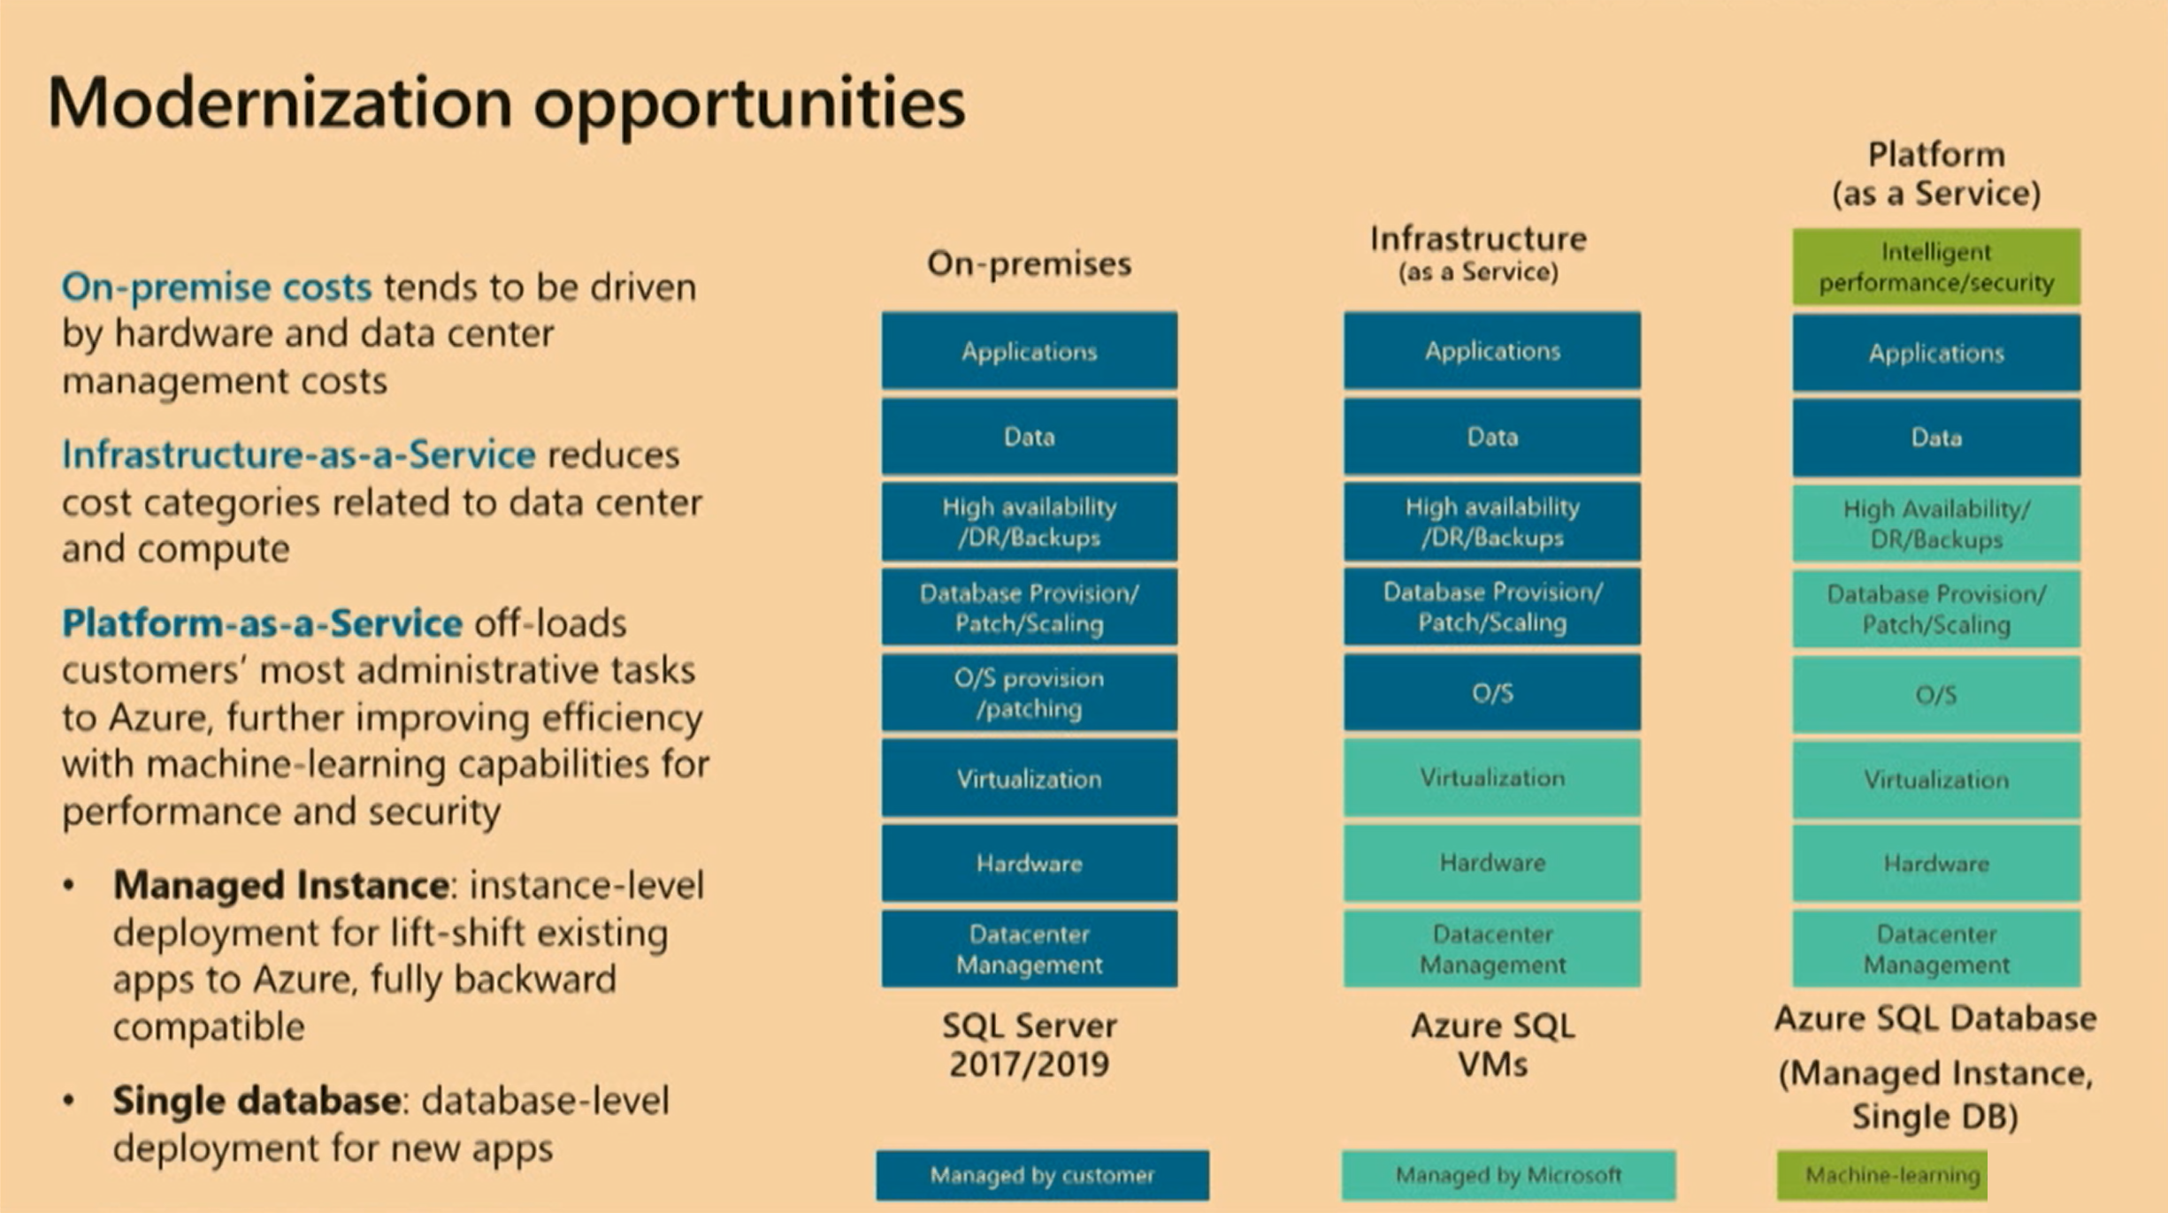

Slide 6
Introducing Azure SQL Database Managed Instance
Azure SQL Database
Single
Elastic Pool
Managed
Instance
SQL
SQL
Standalone managed database for predictable and stable workloads
Shared resource model for greater efficiency through multi-tenancy
Instance-scoped programming model with high compatibility to SQL Server
Best for apps that require resource guarantee at database level
Best for SaaS apps with multiple databases that can share resources at database level, achieving better cost efficiency
Best for modernization at scale with low cost and effort
Notes:
Introducing Azure SQL Database Managed Instance
SQL Database Managed Instance is an expansion of the existing SQL Database service designed to enable database migration to a fully-managed database service, without re-designing the application.
It’s important to note that Managed Instance isn’t a new service – it is a third deployment option within Azure SQL Database, sitting alongside single databases and elastic pools. As part of Azure SQL Database, Microsoft’s fully managed cloud database service, it inherits all its built-in features.
A SQL Database Managed Instance offers a simplified instance-scoped programming model that is like an on-premises SQL Server instance. The databases in a SQL Database Managed Instance share the resources allocated to the Managed Instance, and the Managed Instance also represents the management grouping for these databases. The emphasis of this offering is on high compatibility with the programming model of an on-premises SQL Server and out-of-box support for a large majority of SQL Server features and accompanying tools/services.
Each standalone database is assigned a certain amount of resources via performance tiers: Basic, Standard, and Premium. The emphasis of this offering focuses on a simplified database-scoped programming model and applications with a predictable pattern and relatively stable workload.
An elastic database pool is a shared resource model that enables higher resource utilization efficiency, and all the databases within an elastic pool share predefined resources within the same pool. The emphasis of this offering is on a simplified database-scoped programming model for multi-tenant SaaS apps. The workload pattern is well-defined and is highly cost-effective in multi-tenant scenarios. For ISVs with SaaS apps, the savings can be significant, in the hundreds of thousands of dollars or more.

Slide 7

WHO IS MANAGED INSTANCE FOR?
SQL
Customers looking to migrate a large number of apps from on-premise or IaaS, self-built or ISV provided, with as low migration effort as possible & cost being a crucial factor.

Slide 8
What is SQL Database Managed Instance?
SQL Database (PaaS)
New deployment option enabling friction-free migration of
SQL Server workloads to
a fully-managed service
Managed Instance
Single database
Elastic Pool
Fully-managed service
SQL Server compatibility
Full isolation and security
New purchasing options
Built on the same infrastructure as SQL Database
Provides the same benefits (PaaS)
Fully-fledged SQL instance with nearly 100% compat with on-premise
Contained within your VNet
Private IP addresses
Express Route / VPN connectivity
Transparent
Frictionless
Competitive

Slide 9
Main benefits of the service
* In the evaluation phase
Features |  | Azure SQL DB Single/Elastic | Azure SQL DB MI | SQL Server on Azure VM
Business continuity/disaster recovery | High availability | Built-in | Built-in | User managed
 | Availability SLA | 99.99% | 99.99% | 99.9% - 99.5% - 99.99%
 | Automatic backups | Yes | Yes | Options available to configure
 | Point in time restore | Yes | Yes | No
 | Backup retention | 35 Days | 7 days+ | Depends
 | Geo-replication | Yes | Yes | Yes, user managed
SQL Server surface area | Native backup/restore | No | Yes | Yes
 | Cross-DB Transactions | Partially | Yes | Yes
 | SQL Agent | No | Yes | Yes
 | Database mail | No | Yes | Yes
 | Encryption | TDE/Always Encrypted | TDE/Always Encrypted | Yes
 | Filestream/filetable | No | No* | Yes
Built-in intelligence | Automatic tuning | Yes | Yes | Partial (plan corrections)
 | Threat detection | Yes | Yes | No
 | Vulnerability Assess. | Yes | No* | No
 | Intelligent Insights | Yes | Yes | No

Slide 10
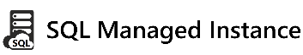
How to easily migrate and get benefits of cloud?
Migrate*
Rehost
(lift and shift)
Enables rehosting or light refactoring for most apps
Enables optimization during or post migration (fully managed service)
Refactor
Assess
Optimize
Rearchitect
Eliminates the need
to rearchitect or
rebuild your apps
IaaS (virtual machines) fall short here
Rebuild

Slide 11
Save time with familiar SQL Server tools and resources
Full compatibility with SQL Server 2005+
Eliminate app changes with full SQL Server programming surface
Use familiar SQL Server features in Managed Instances
Native backup and restore
Cross-database queries and transactions
Security features including Transparent Data Encryption, SQL Audit, Always Encrypted and Dynamic Data Masking
SQL Agent, DBMail, for workload orchestration improved awareness
Scenario enablers: Change Data Capture, Service Broker, Transactional Replication, and CLR
DMVs, XEvents, and Query Store for troubleshooting
Notes:
SQL Database Managed Instance reduces the differences between on-premise SQL Server and a fully managed database service, so that the migration becomes much easier.
SQL Database Managed Instance offers a simplified instance-scoped programming model that is like an on-premises SQL Server instance. The databases in Managed Instance share the resources allocated to the Managed Instance, and the Managed Instance also represents the management grouping for these databases. The emphasis of this offering is on high compatibility with the programming model of on-premises SQL Server and out-of-box support for the large majority of SQL Server features and accompanying tools/services.

Slide 12

Database Compatibility Based Certification
Microsoft Database Compatibility Level Protection
Full Functional protection once assessment tool runs clean.
Query Plan shape protection.
Overall process
Use Database Migration Assistant (DMA) and Database Experimentation Assistant (DEA) for assessment.
Migrate database and keep/set source Database Compatibility Level on target.
Perform minimal testing or as determined by your organization.

Slide 13
Easy migration: nearly 100% like SQL Server
Data migration
DMS (migrations at scale)
Native backup/restore
Configurable DB file Layout
Log Replay *
Security
Integrated Auth (AAD)
Encryption (TDE, AE)
Row Level Security
SQL Audit
Vulnerability Assessment
Dynamic Data Masking
Programmability
Cross-database queries and transactions
.NET
Linked servers
Global temp tables
Operational
DMVs & XEvents
Query Store
SQL Agent
DB Mail (external SMTP)
Scenario enablers
Service Broker
Change Data Capture
Transactional Replication

Slide 14
Service Tiers
Notes:
SQL DB uses Public VMs hosting database engine
Managed Instance – Tenant Isolation via use of own dedicated VM’s that are injected into Customer VNet

Slide 15
Service tiers
General Purpose
Business Critical
Hyper Scale
General Workloads
Low latency workloads
Fast Recovery
Free Read-Only Replica
VLDB(~100TB)
Hybrid Workload
Read-Only Replica’s

Slide 16
Service Tiers | GENERAL PURPOSE | BUSINESS CRITICAL | HYPERSCALE (coming soon)
Best for | Data applications with common IO and availability requirements | Business critical data applications with fast IO and high availability requirements | Customers who seek high performance and high scalability for storage and compute.
Number of vCores | Gen4: 8, 16, 24 Gen5: 8, 16, 24, 32, 40, 64, 80 | Gen4: 8, 16, 24, 32 Gen5: 8, 16, 24, 32, 40, 64, 80 | Gen5: 1 to 80
Memory | Gen4: 7 GB per vCore Gen5: 5.1 GB per vCore | Gen4: 7 GB per vCore Gen5: 5.1 GB per vCore | N/A
Max storage size | 8 TB | Gen4: 1 TB Gen5: - 1 TB for 8, 16 vCores - 2 TB for 24 vCores - 4 TB for 32, 40, 64, 80 vCores | 100+ TB
Notes:
Gen 4Gen 5HardwareIntel E5-2673 v3 (Haswell) 2.4 GHz processors, attached SSD vCore = 1 PP (physical core)Intel E5-2673 v4 (Broadwell) 2.3 GHz processors, fast eNVM SSD, vCore=1 LP (hyper-thread)Performance levels8, 16, 24 vCores8, 16, 24, 32, 40, 64, 80 vCoresMemory7 GB per vCore5.5 GB per vCore

Slide 17
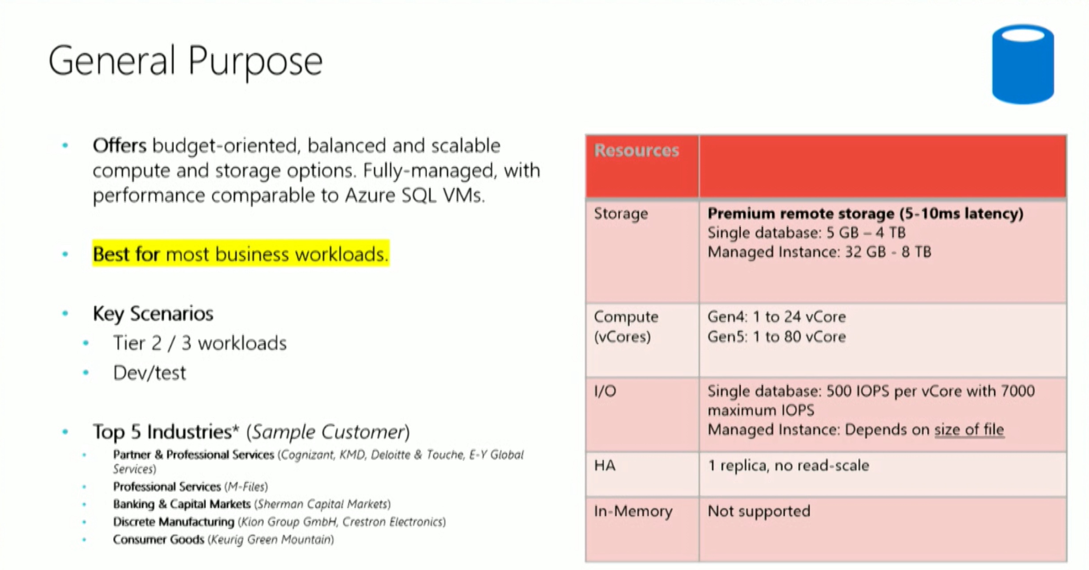

Slide 18
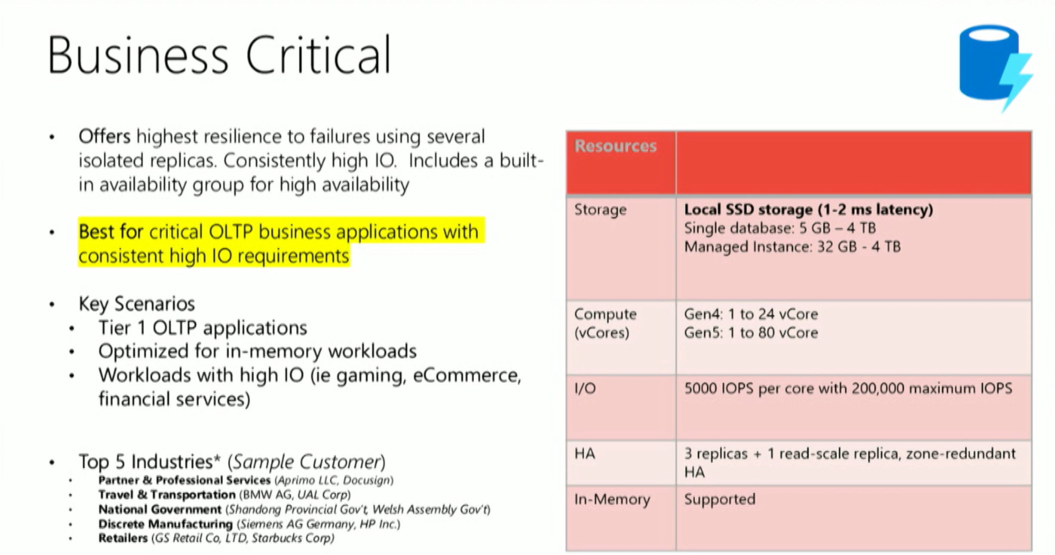

Slide 19
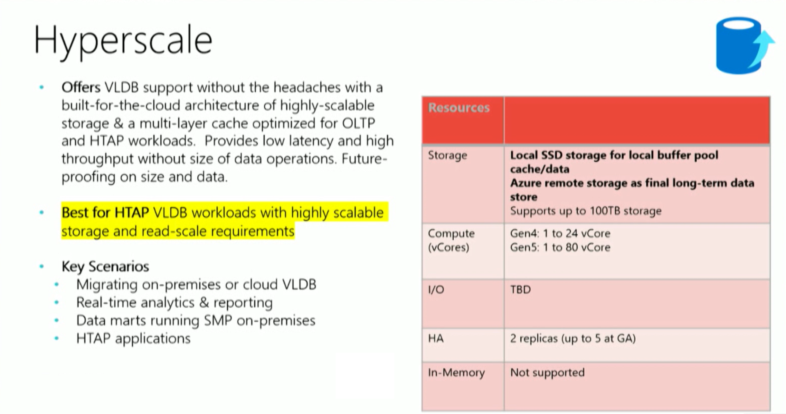

Slide 20
Availability
Supported regions
Managed Instanced can be created only in supported regions. If you want to create a Managed Instance in the region that is currently not supported, you can send support request via Azure portal.
https://azure.microsoft.com/en-au/global-infrastructure/services/?products=sql-database&regions=all
Supported subscription types
Managed Instance currently supports deployment only on the following types of subscriptions:
Enterprise Agreement (EA)
Pay-as-you-go
Cloud Service Provider (CSP)
Enterprise Dev/Test
Pay-As-You-Go Dev/Test

Slide 21

AZURE HYBRID BENEFIT (AHB): Get more for your virtualized workloads
SQL Server license trade-in values
SQL Database Managed Instance
Take an inventory of on-premises licenses to determine potential for conversion
Convert on-premises cores to vCores to maximize value of investments
1 Standard license core = 1 General Purpose core
1 Enterprise license core = 1 Business Critical core
1 Enterprise license core = 4 General Purpose cores (virtualization benefit)
General Purpose
Business Critical
General Purpose
OR
Highly virtualized, Enterprise Edition
Enterprise Edition
Standard Edition
SQL Server with Software Assurance

Slide 22
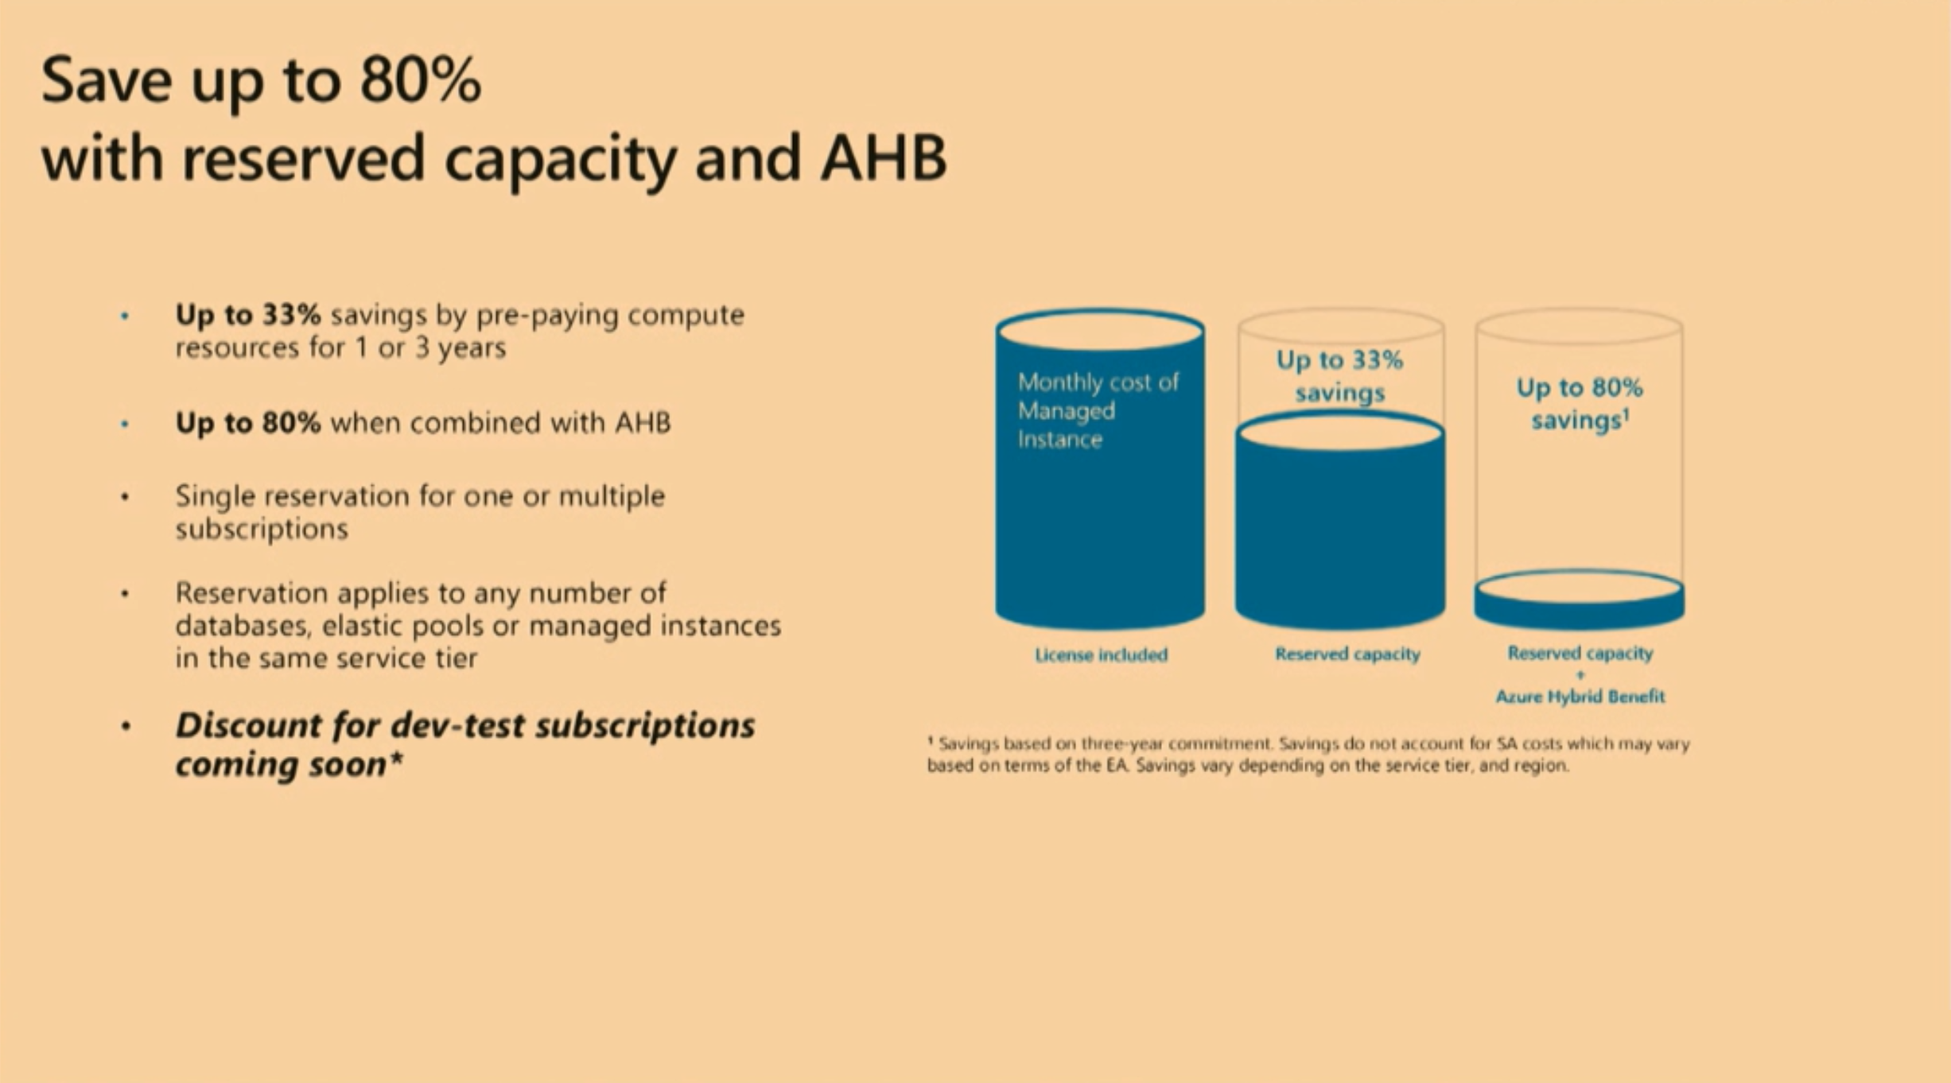

Slide 23
Isolation and Connectivity
Notes:
SQL DB uses Public VMs hosting database engine
Managed Instance – Tenant Isolation via use of own dedicated VM’s that are injected into Customer VNet

Slide 24
Dedicated resources through customer isolation
VNET support in SQL Database Managed Instance
VNet-to-VNet
Enable full isolation from other tenants without resource sharing
Promote secure communication over private IP addresses with native VNET integration
Enable your on-premise identities on cloud instances, through integration with Azure Active Directory and AD Connect
Plan your deployment for enough IP addresses in your Vnet address space in your subnet
UDR and NSG limitations
Web app (public IP)
VNet2
SQL instance #1
SQL instance #2
Network isolation (customer VNET)
Tenant isolation (compute, storage)
SQL instance #3
VNet1
“Virtual data cluster” dedicated to customer (virtual private cluster, VNET, private IPs)
VPN/Express route gateway
On-premises
Notes:
SQL Database Managed Instance provides complete workload isolation of your workloads through native VNET support. We use virtual data clusters to describe the degree of isolation that customer workloads will experience with SQL Database Managed Instance. During service provisioning (on Azure Portal or through REST API), you can choose the virtual network (VNET) and the subnet to achieve full networking isolation for your Managed Instances. Once created, instances in the VNET can be reached using Azure networking mechanisms (VPN and Express Route gateways).
To two levels of isolation are provided:
Cluster (tenant ring) level: Managed Instances for a tenant are fully isolated from other tenants. No connectivity or resource sharing is possible between different tenants.
Networking level: joining instances to a subnet in a VNET and restricting access to private IP addresses only provides full isolation from public Internet.
Deployment
Managed Instance requires a minimum of 16 IP addresses in a subnet and may use up to 256 IP addresses
If deploying multiple Managed Instances inside the subnet, you need to optimize the subnet size
The default values create a subnet that takes all the VNet address space, allowing for only Managed Instance inside the virtual network

Slide 25
Host your Application in the Cloud or keep on-premises
App subnet
“VNet Integrated”
web app
“VNet Integrated”
web app (peered VNet)
App Service
Environment
3
4
1
2
IaaS hosted app
Application VNet
Peering / VPN channel
MI subnet
App subnet
5
IaaS hosted app
App Service
Environment
6
Managed Instance #1
Managed Instance #2
7
On-premises app
Express Route / VPN Gateway

Slide 26






Network communications
certificate verification
Certificate Authorities
Internet
TLS
TLS
Management & Deployment Plane
Azure
Azure SQL Database
Managed Instance
TLS
Service dependencies Azure
Customer applications & tools
On-Premises + Azure VNet

Slide 27
Connecting to Managed Instances
Latest driver versions provides best connectivity experience
Do not forget that MI is available on private endpoint – test connectivity for your scenarios
Public endpoint is coming later this year
Build connectivity resilience into your code to protect from transient faults
Continue using well-known SQL Server tools (SSMS, SSDT) – install latest version
SQL Authentication
Azure AD
Token-based authentication for applications connecting to SQL Database
ADFS or native user/password authentication for a local Azure Active Directory without domain synchronization
Multi-Factor Authentication (MFA)
Notes:
Windows logins are not supported
CREATE LOGIN .. FROM WINDOWS is not permitted
Azure AD user who creates the Managed Instance has unrestricted administrative privileges by default
This can be changed from an individual to a security group account
Azure AD non-admin database users can be created using CREATE USER … FROM EXTERNAL PROVIDER syntax
SQL logins are fully supported when created using:
FROM CERTIFICATE
FROM ASYMMETRIC KEY,
FROM SID

Slide 28
Creating your first Managed Instance
Portal

Slide 29
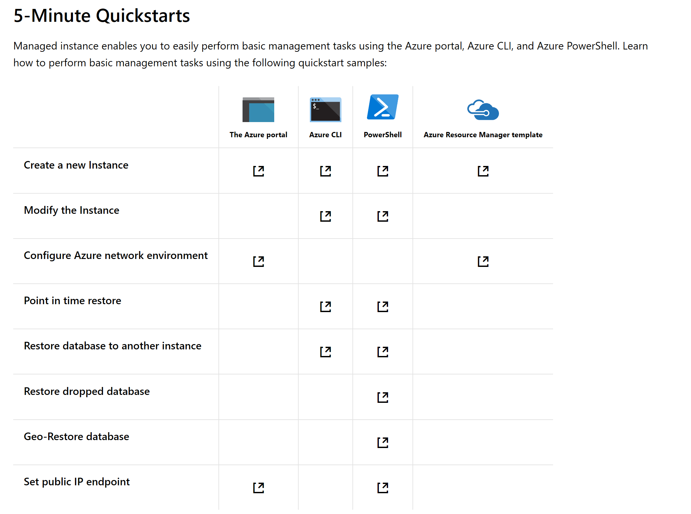

Slide 30
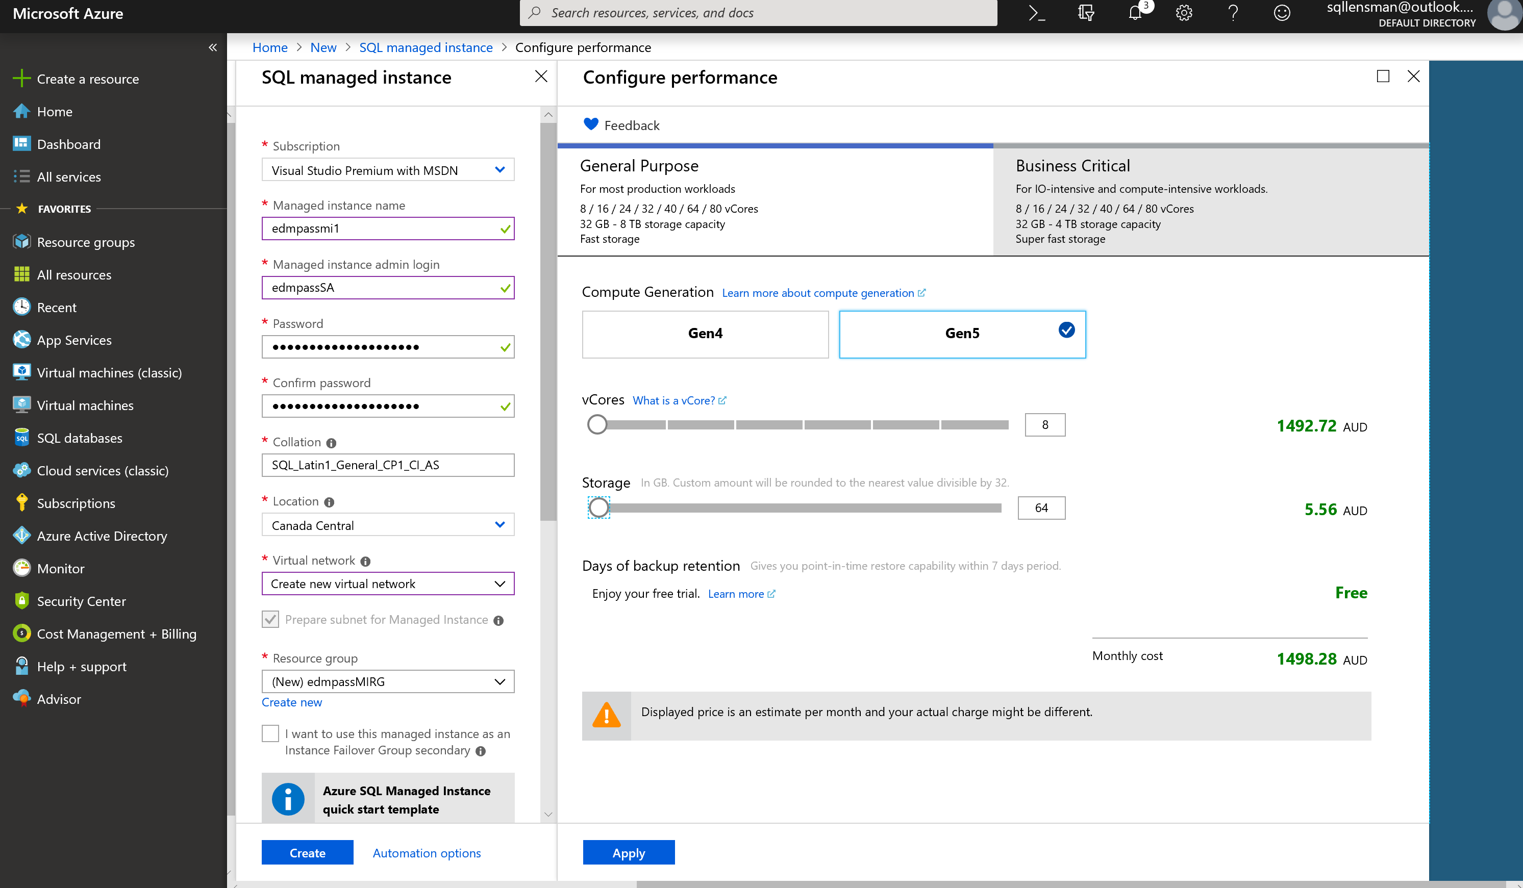
Notes:
Not actually available on a MSDN Subscription Currently needs a paid subscription

Slide 31
Managed Instance Features

Slide 32
SURFACE AREA
MI is always on latest and greatest SQL engine version
Certify your code for database compatibility level not for a version
Take advantage of new features (Temporal, JSON, Graph Database, etc.)
Use rich T-SQL surface area, check out documentation page
Your code can be SQL version aware if necessary
SERVERPROPERTY (‘EngineEdition’) = 8 uniquely identifies MI
Current limitations (will be removed later this year)
Time is UTC . Use AT TIME ZONE to add local time zone experience
Instance collation is fixed (affects tempdb and system databases)
Fixed
Fixed
Notes:
https://azure.microsoft.com/en-us/updates/server-level-collations-in-managed-instance-are-globally-available/

Slide 33

USER DATABASE FILE LAYOUT CONSIDERATIONS
Data file default initial size is 16MB with 16MB autogrowth
These can and should be adjusted for your workload
File size limit is 8TB in General Purpose
Log file default initial size is 8MB with 16MB autogrowth
This can and should be adjusted for your workload
Multiple log files are not supported
Additional data files/filegroups can be added
Only using an ALTER DATABASE statement and the FILENAME clause is not permitted
Paths and File Names are chosen for you
Different from Azure SQL Database where additional files are not allowed
Notes:
MI GP uses Azure Premium Storage to store database files for all databases, except for the tempdb database. From the perspective of the database engine, this storage type is remote, i.e. it is accessed over the network, using Azure network infrastructure. To use Azure Premium Storage, MI GP takes advantage of SQL Server native capability to use database files directly in Azure Blob Storage. This means that there is not a disk or a network share that hosts database files; instead, file path is an HTTPS URL, and each database file is a page blob in Azure Blob Storage.
The current implementation of MI GP does not use blobs smaller than 128 GB (P10). The system will use 128 GB (P10) blobs even for very small database files, to avoid negative performance impact that would be likely with smaller blob sizes (P4 and P6). Additionally, when allocating blobs in Premium Storage, MI always uses the maximum blob size within a storage performance tier.
For example, if database file size is 900 GB, MI GP will use a 1 TB (P30) blob for that file. In other words, blob size is snapped up to the maximum size of each storage performance tier. If the file grows above that limit, the system automatically increases blob size to the maximum of the next performance tier. Conversely, if the file is shrunk below the maximum size of a performance tier, blob size is automatically reduced as well.
For billing purposes, MI uses the configured instance file size limit (8 TB or less), not the larger blob size allocated in Azure Premium Storage.
As mentioned earlier, the tempdb database is not using Azure Premium Storage. It is located on the local SSD storage, which provides very low latency and high IOPS/throughput. This article focuses on databases that use remote storage.
Managed Instance Business Critical (BC) instances do not use remote Azure Premium Storage, but instead use local SSD storage. Storage performance considerations discussed in this article do not apply to BC instances.

Slide 34
Backup aND RESTORE
Database backup schedule is the same as Azure SQL Database
COPY_ONLY, URL-based backups can be used to perform manual full database backups
Not available on Azure SQL Database
Backup retention is 7 days by default
Configurable up to 35 days for General Purpose and Business Critical
Point-in-time restores are possible and must be performed manually using the Azure Portal
COPY_ONLY, URL-based full backups can be restored using SSMS to a Managed Instance only
Notes:
Backups:
Full database backups occur weekly
Differential backups generally happen every few hours
Transaction log backups generally happen every 5-10 minutes
Frequency is based upon performance level and amount of database activity
Restore:
Restoring automated backups from within SSMS is not allowed.
You can only restore using the Azure Portal
Cannot be restored to on-premises as Managed Instance uses a higher build than on-premises instances

Slide 35

TempDB
Multiple data files created automatically with default size (16MB) and auto-growth settings (256MB data, 64MB log)
01
Additional tempdb data files can be created if needed
02
Service cannot be restarted manually, so fix the growth and max file size (shrink is possible)
03
Notes:
Backups:
Full database backups occur weekly
Differential backups generally happen every few hours
Transaction log backups generally happen every 5-10 minutes
Frequency is based upon performance level and amount of database activity
Restore:
Restoring automated backups from within SSMS is not allowed.
You can only restore using the Azure Portal
Cannot be restored to on-premises as Managed Instance uses a higher build than on-premises instances

Slide 36
High Availability
High Availability is handled behind the scenes automatically
For General Purpose there is a two-node Availability Group
The secondary is non-readable
For Business Critical there is a three-node Availability Group
One secondary is readable and the other is non-readable
Transactional replication from on-premises to Managed Instance and Managed Instance to on-premises is supported
Log shipping, DB mirroring and Availability Group cannot target a Managed Instance

Slide 37
SCALING MANAGED INSTANCE
Performing an upscale/downscale operation can cause a loss of connectivity to the Managed Instance
Same as for Azure SQL Database
Applications written to be resilient to this (i.e. HA-aware) should reconnect automatically
Speed of the operation depends on the tier
General Purpose is fast
Business Critical can vary widely as it may be a size-of-data-operation
E.g., if new replicas must be created and initialized, or new hardware must be provisioned
HyperScale should be fast

Slide 38
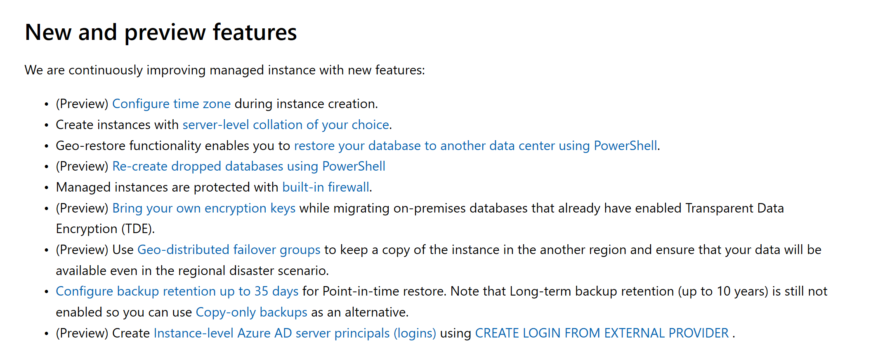

Slide 39
Managed Instance Limitations

Slide 40


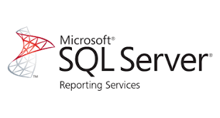
Business Intelligence Services
Recommendation - move BI solutions to PaaS model
PowerBI
Not installed side-by-side with Managed Instance
Migrate your SSIS packages to new SSIS on Azure Data Factory (PaaS service)
Migrate your OLAP models to Azure Analysis Services
… or run these services in Azure virtual machines
For SSRS: run in a virtual machine, or switch to Power BI
SSIS / SSAS PaaS
SSIS / SSAS
Notes:
SQL Database Managed Instance reduces the differences between on-premise SQL Server and a fully managed database service, so that the migration becomes much easier.
SQL Database Managed Instance offers a simplified instance-scoped programming model that is like an on-premises SQL Server instance. The databases in Managed Instance share the resources allocated to the Managed Instance, and the Managed Instance also represents the management grouping for these databases. The emphasis of this offering is on high compatibility with the programming model of on-premises SQL Server and out-of-box support for the large majority of SQL Server features and accompanying tools/services.

Slide 41
Design Limitations
Memory is proportional to Number of vCore
Gen4: 7 GB per vCore Gen5: 5.1 GB per vCore
IO Latency in General Purpose service tier
IO Latency in General Purpose service tier is proportional to size of data file.
P10 Disk of 128GB – 500 IOPS , 100 MB/s throughput per disk
P40 Disk of 2048GB – 7,500 IOPS , 250 MB/s throughput per disk
TempDB
Size of TempDB in General Purpose service tier is set as 24GB per Vcore

Slide 42
App compatibility: what’s is missing?
Features with a better alternative in Azure
Always-On Availability Groups: local HA, active geo-replication
Windows Authentication: Azure Active Directory is the alternative.
Management Data Warehouse : OMS integration is the alternative.
Retired features
Database Mirroring: built-in HA / geo-replication
Extended stored procedures: customers should use CLR
Features considered post-GA
Filestream, Filetable
Cross-instance distributed transactions (MS DTC)
Stretch Database
PolyBase

Slide 43
Other Limitations
No Access via Public Endpoint (11/04/2019)
Access for PowerBI via On-Premesis Gateway
Subnet
Subnet used by Managed Instance cannot be used by other resources
Collation
Collation must be set when Managed Instance created and cannot be changed.
T-SQL
https://docs.microsoft.com/en-us/azure/sql-database/sql-database-managed-instance-transact-sql-information
Notes:
https://techcommunity.microsoft.com/t5/Azure-SQL-Database/Public-endpoint-for-SQL-Database-Managed-Instance-is-available/ba-p/438996

Slide 44
Migration to Managed Instance ?

Slide 45
Decision Criteria
Do you need any of the unavailable features of Azure SQL Db?
Managed instance is your only choice if you want a managed service.
Are you migrating from SQL Server or starting new development?
Managed instance is easier for migration.
Is chargeback accuracy important for your database costs?
Single database model is the most accurate.
Are you planning a 50TB+ DW?
Azure SQL DW is the best offering for long term large DW growth.
Are you planning a smaller 1-30 TB Data Mart?
Managed instance or Azure SQL DB HyperScale .

Slide 46
Migration path
Assess Managed Instance compatibility
Choose app connectivity option
Deploy optimally sized Managed Instance
Choose migration method and migrate
Monitor
Database Migration Assistant

Slide 47
Migration path
Assess Managed Instance compatibility
Choose app connectivity option
Deploy optimally sized Managed Instance
Choose migration method and migrate
Monitor
Database Migration Assistant
Backup to URL
Azure Database Migration Service
T-SQL or PowerShell for instance-level entities

Slide 48
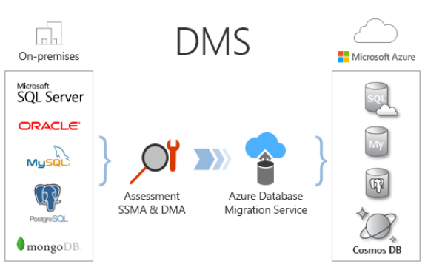
Migration phase
Backup / Restore to Azure Blob Storage
SQL2016+: Backup to URL (SAS token in Credential)
SQL2012 SP1 CU2 – SQL2016: Backup to URL (SA key in Credential - deprecato)
Legacy versions: Manual copy (azCopy, Storage Explorer, etc.)
Database Migration Service
Managed Service
Standard → migration offline
Premium → migration online
Must be able to connect to the instance to migrate

Slide 49
Migration path
Assess Managed Instance compatibility
Choose app connectivity option
Deploy optimally sized Managed Instance
Choose migration method and migrate
Monitor
Query Store
Database Experimentation Assistant
A/B testing
Database Migration Assistant
Backup to URL
Azure Database Migration Service
T-SQL or PowerShell for instance-level entities
Notes:
Database Exper

Slide 50
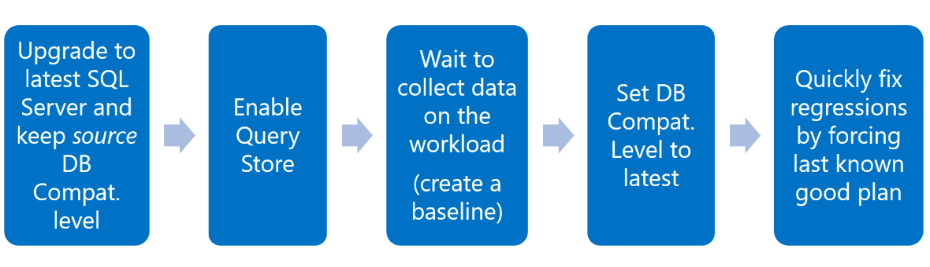
Monitoring
Capture and replay workloads to find regressions
https://github.com/spaghettidba/WorkloadTools

Slide 51
Managed Instance - HyperScale

Slide 52
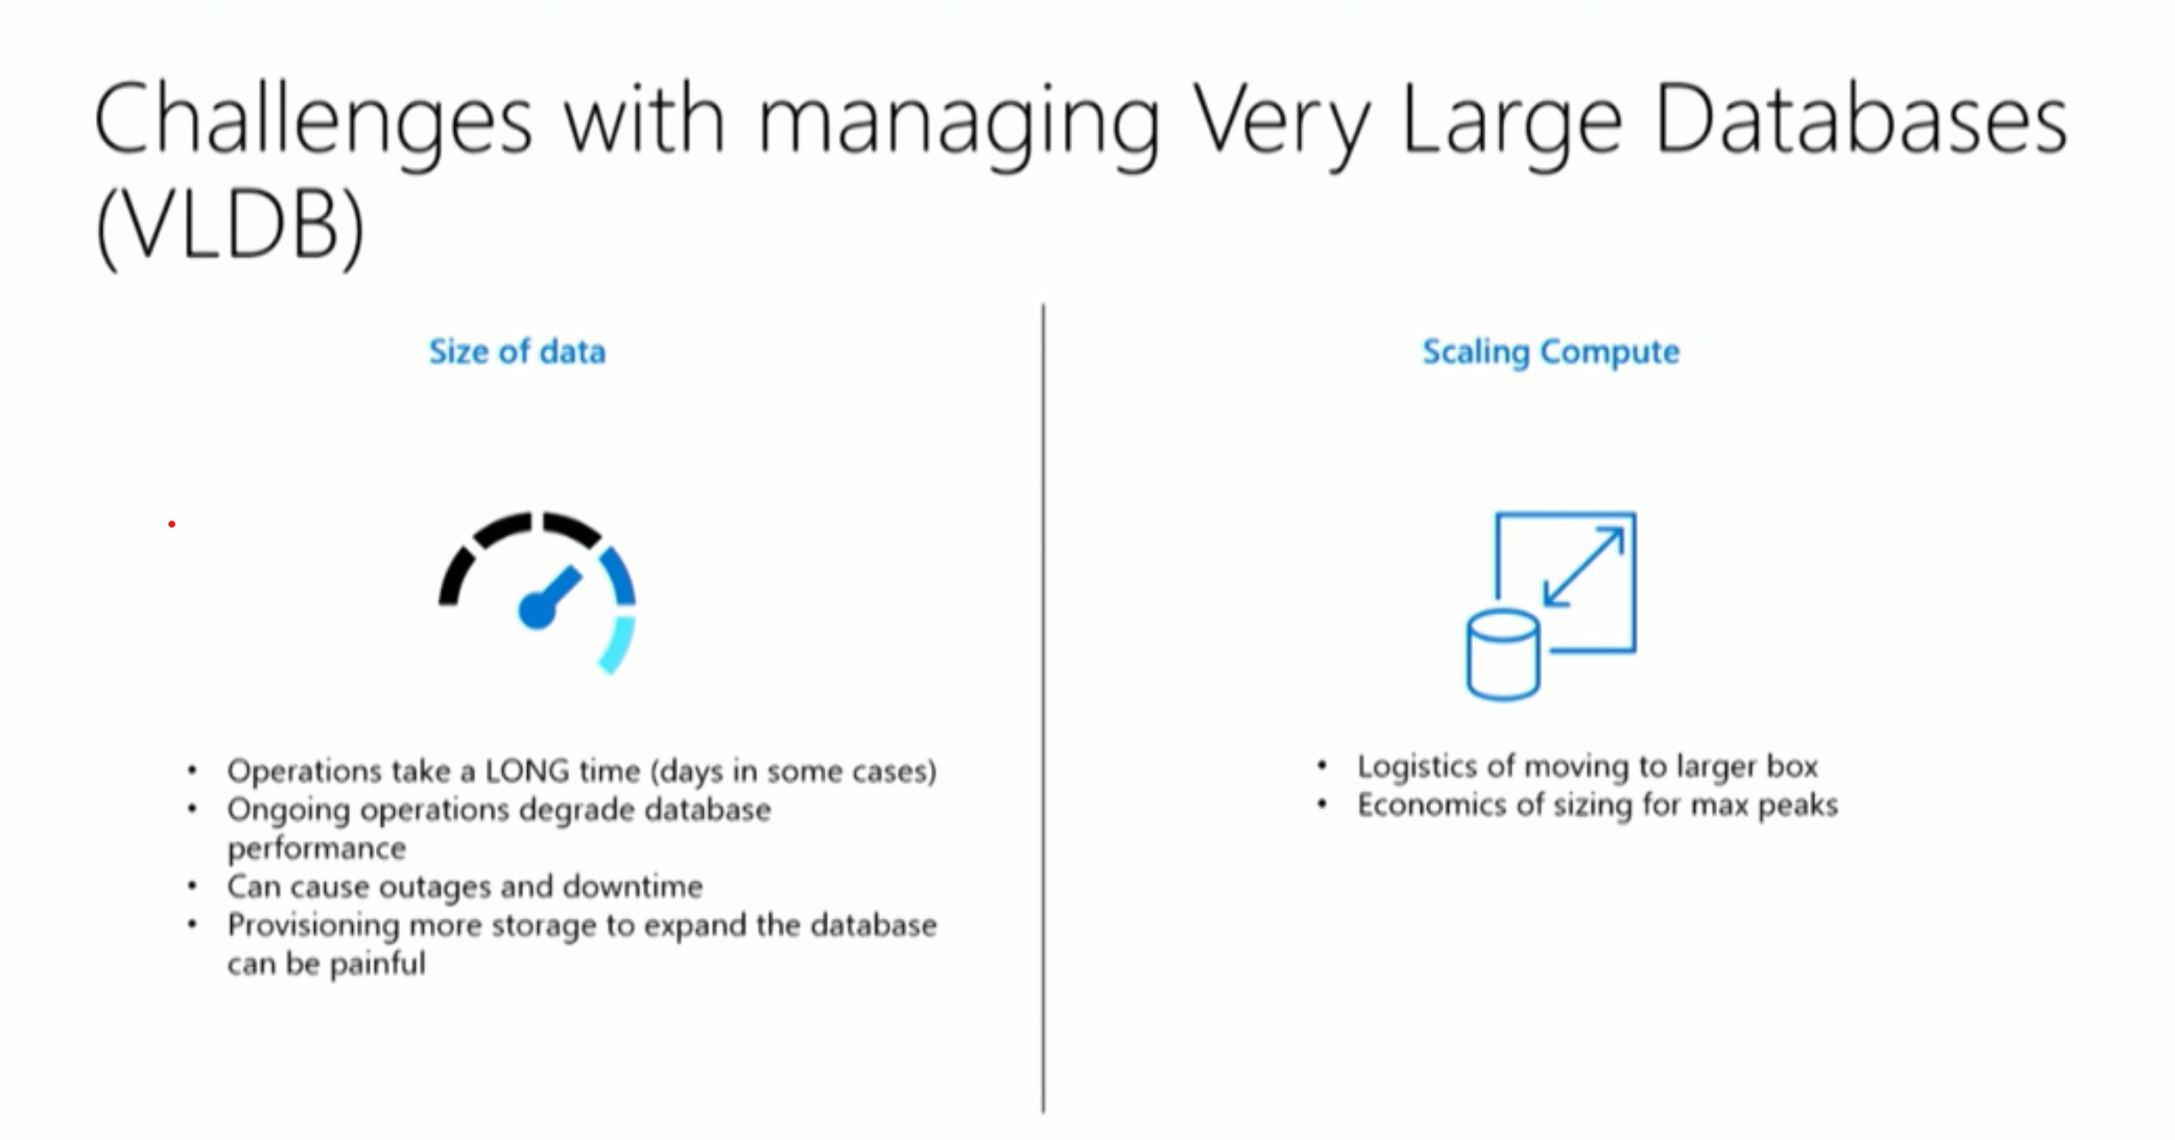

Slide 53
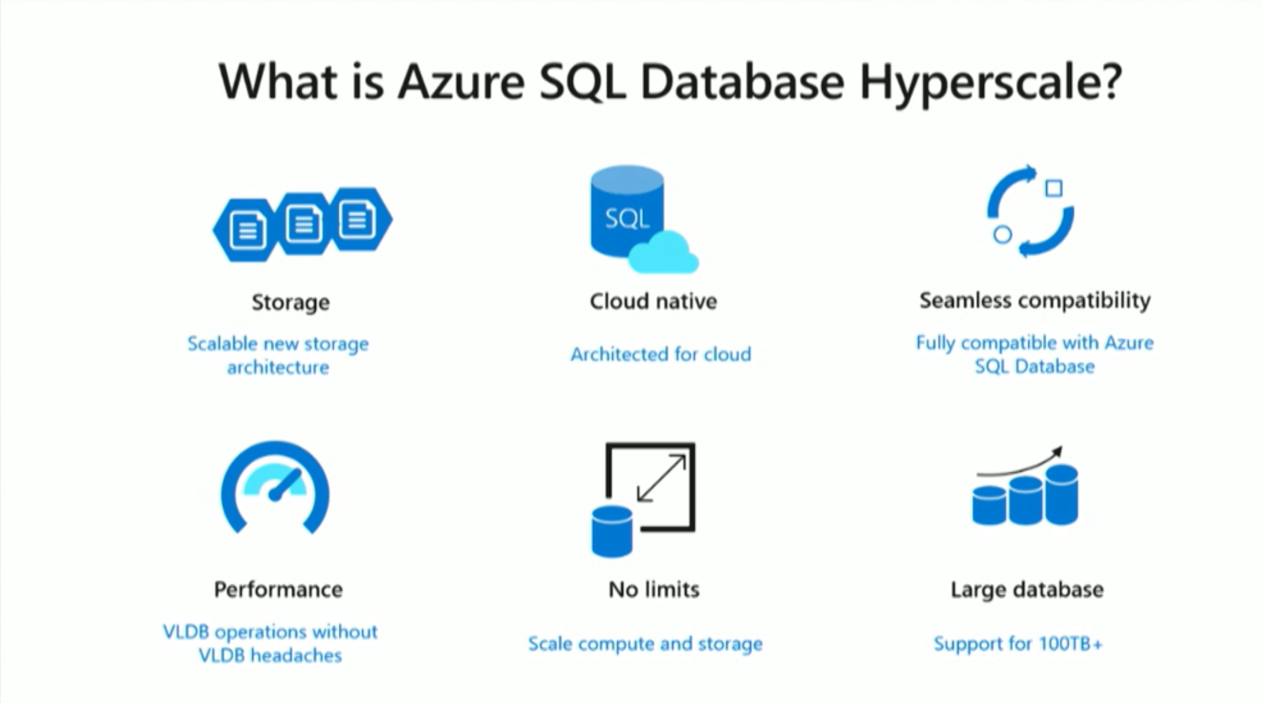

Slide 54
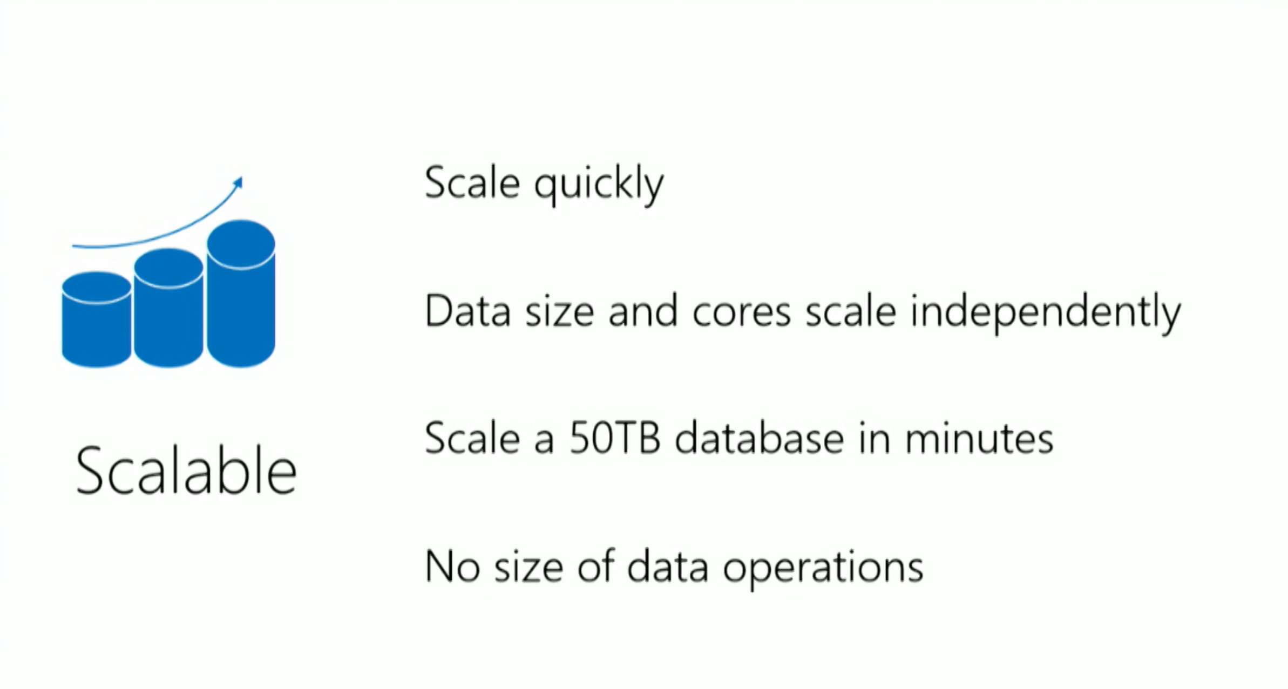

Slide 55
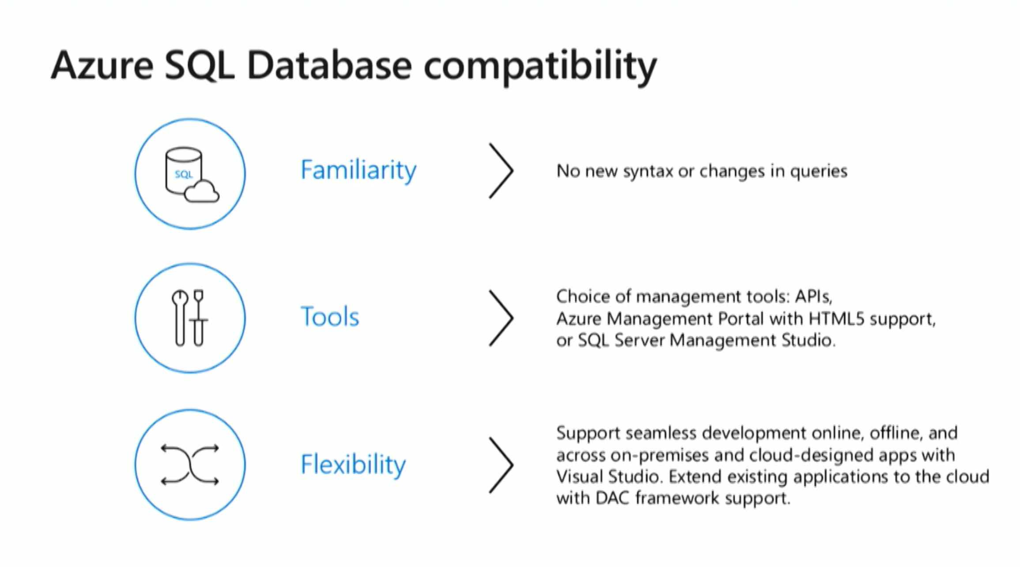

Slide 56
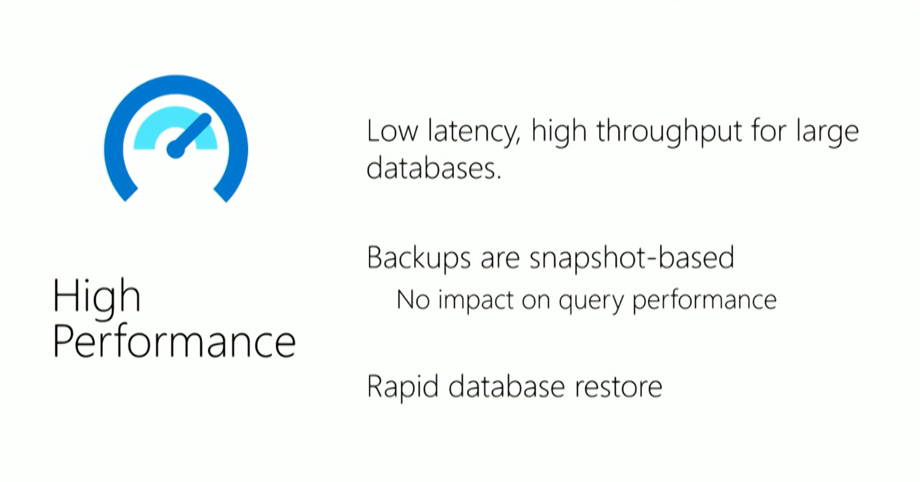

Slide 57
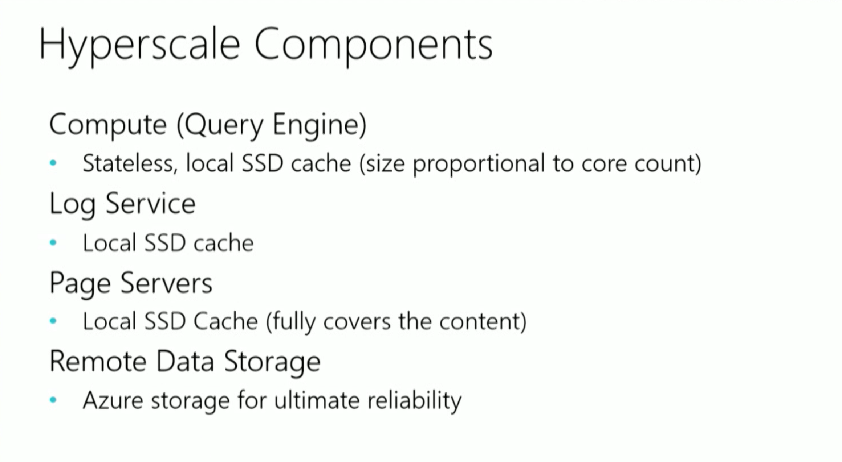
Notes:
Compute – Same Query engine as any other version of Azure SQL DB
Log Service – Has own compute
Page Servers – 1TB size each running own version of SQL Server

Slide 58
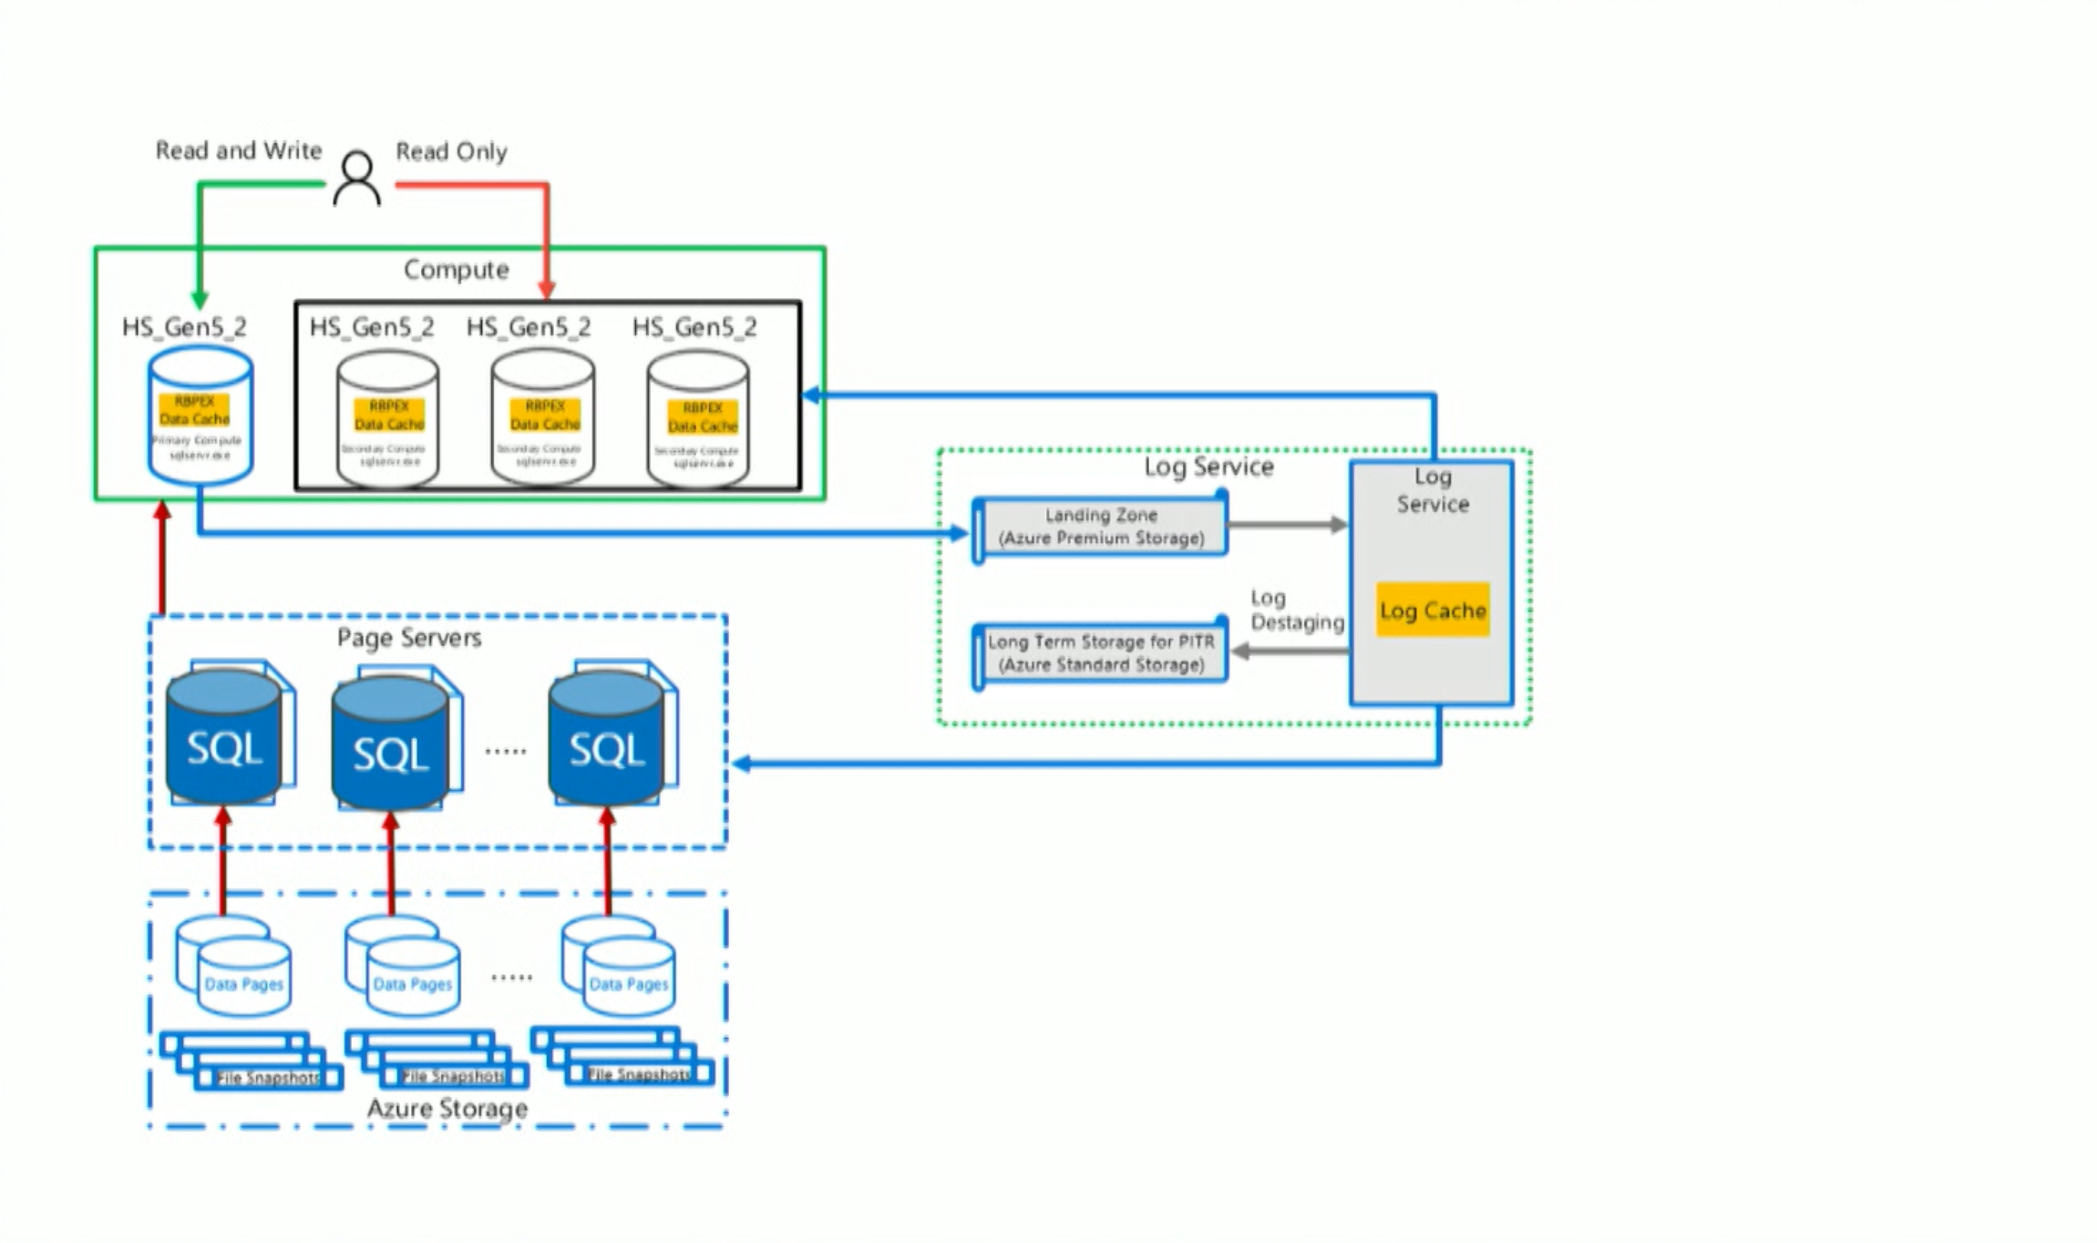

Slide 59
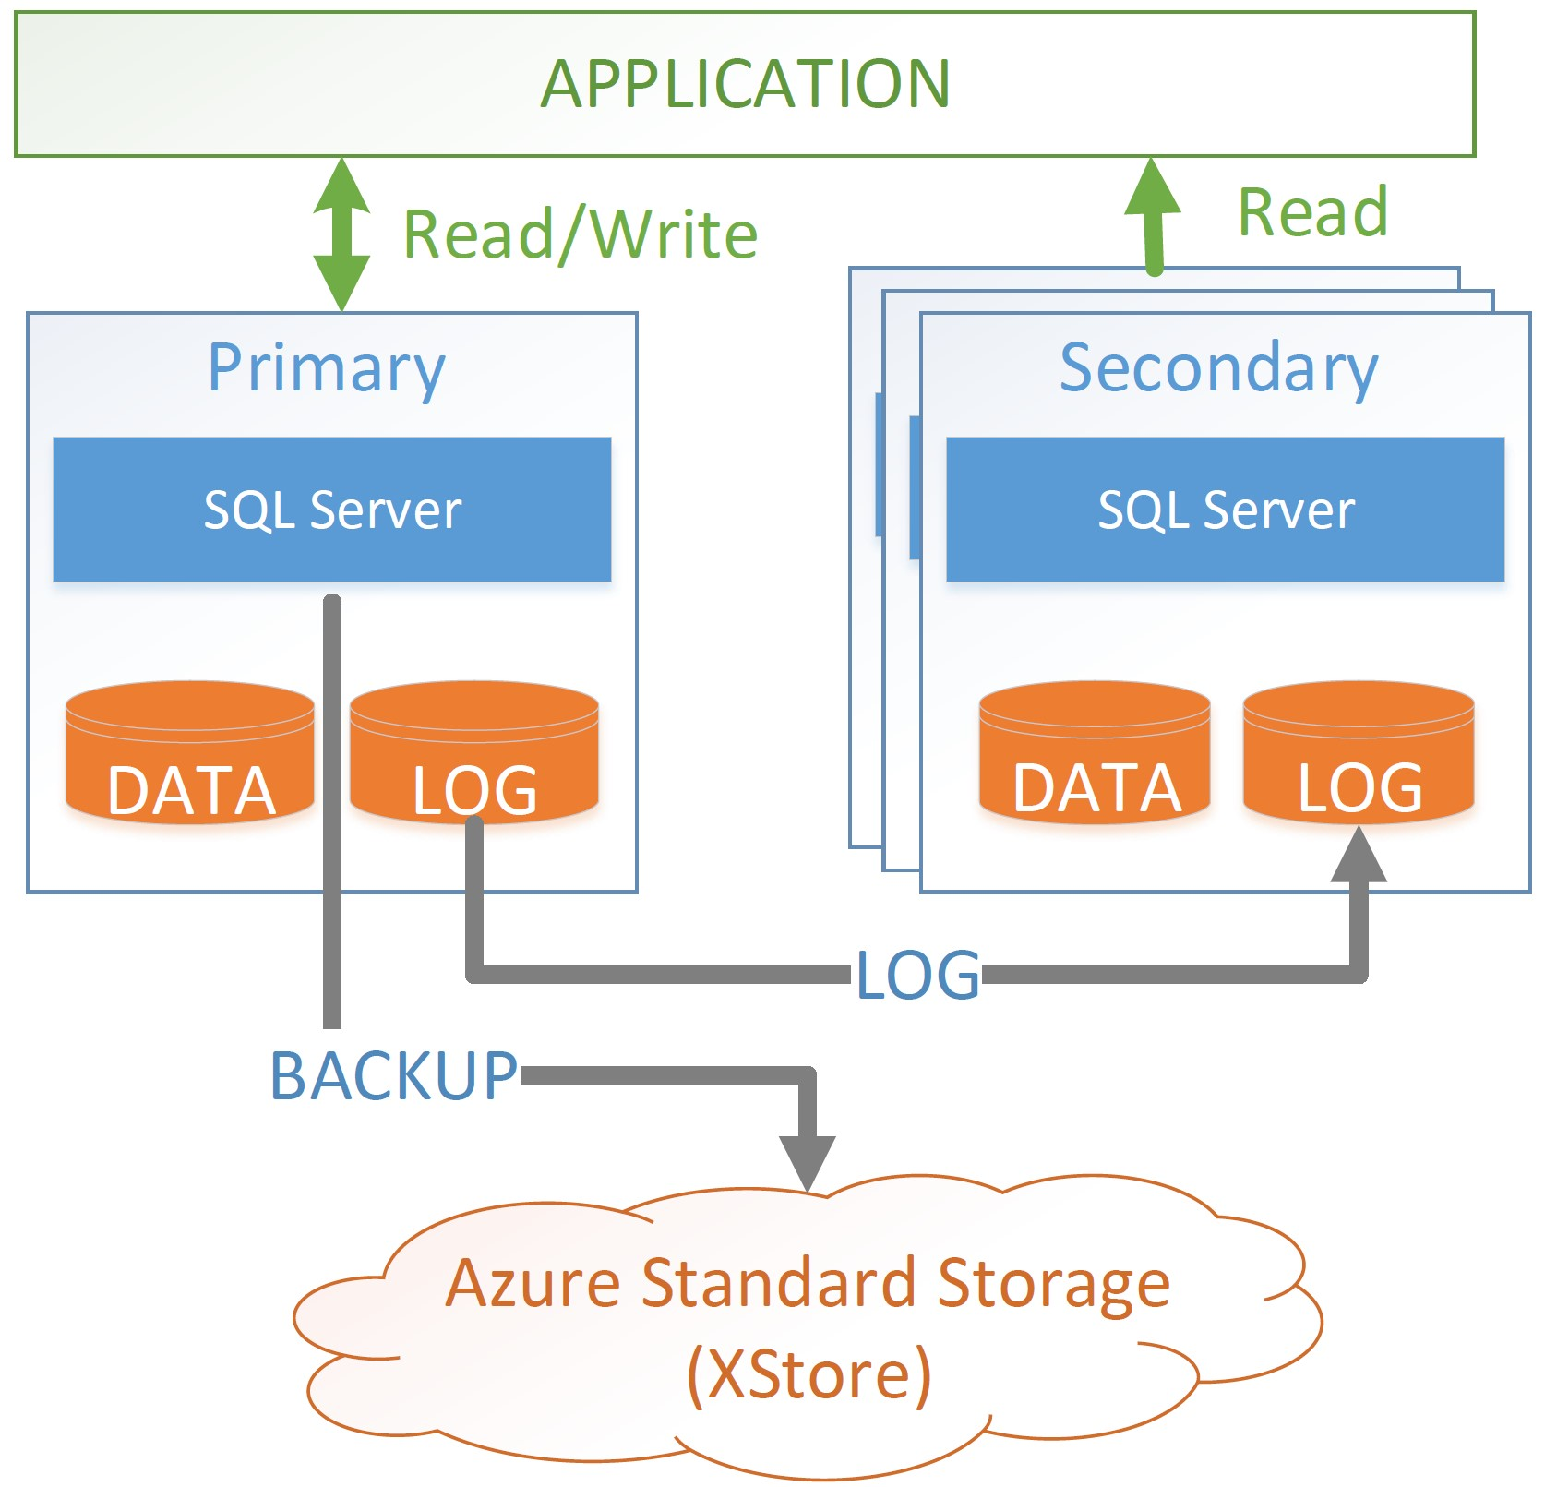
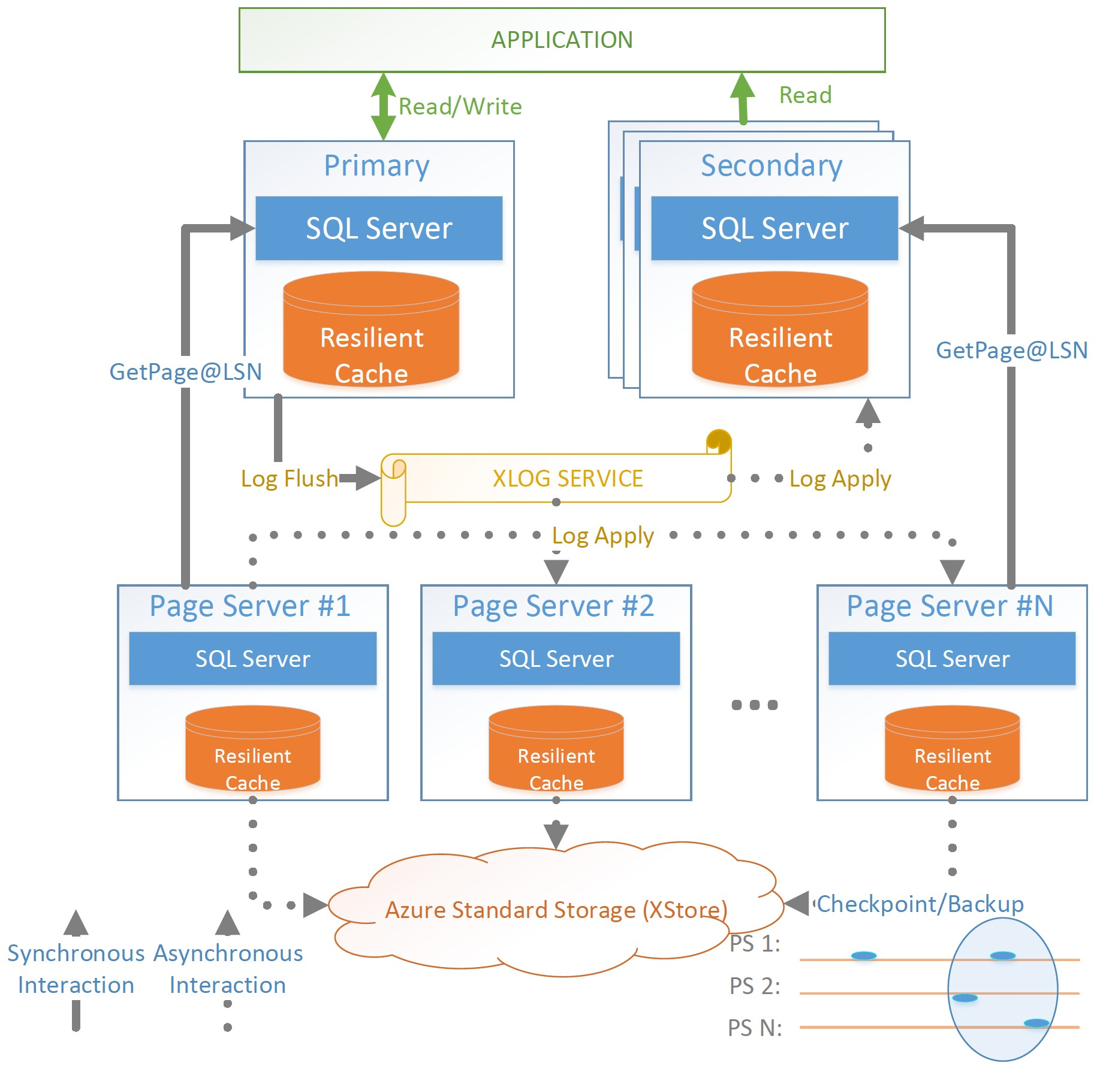
Comparison between Hyperscale and Existing

Slide 60
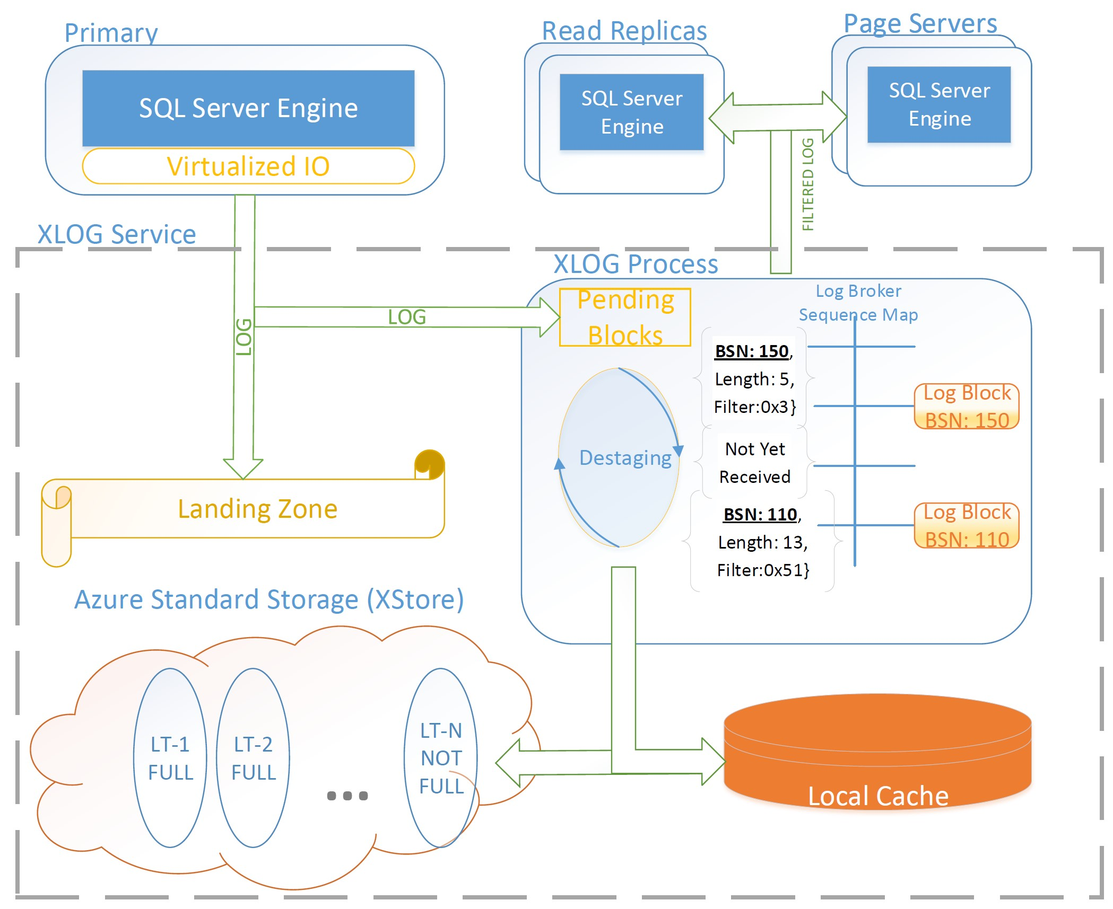
XLOG Service

Slide 61
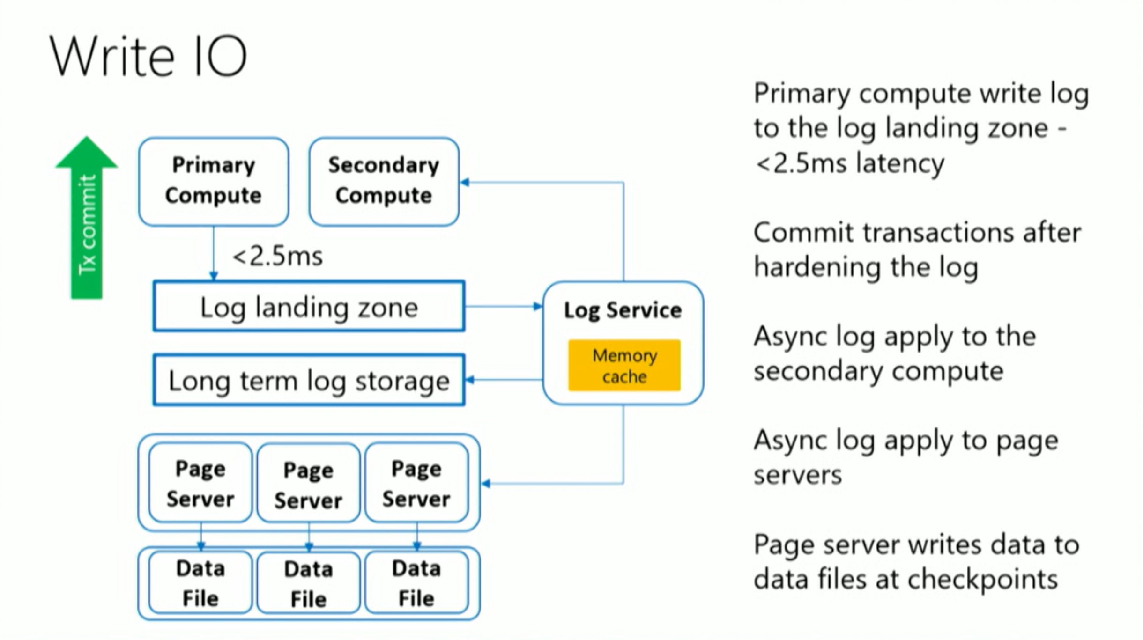

Slide 62
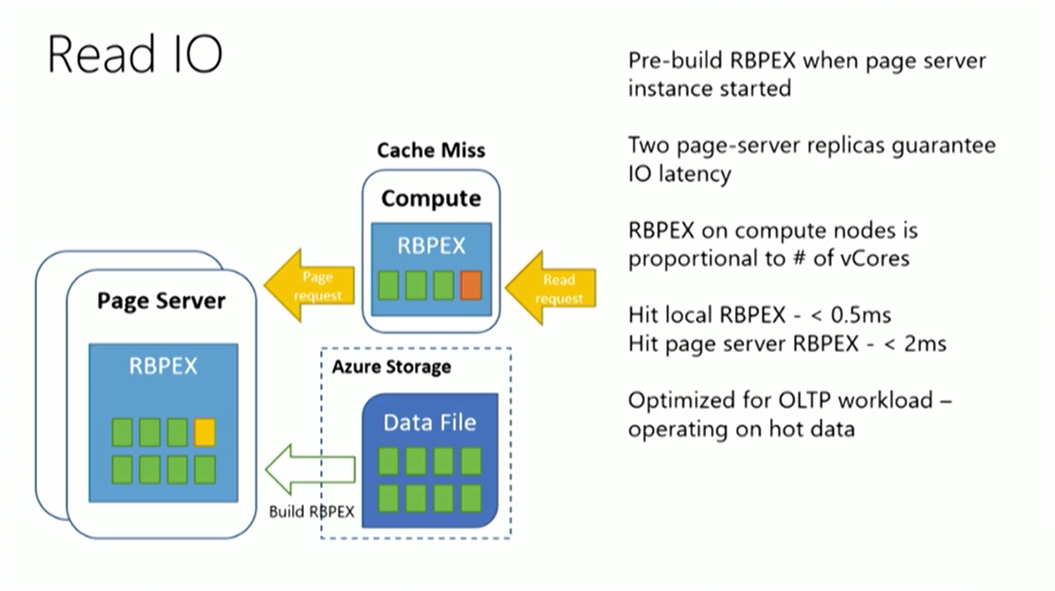

Slide 63
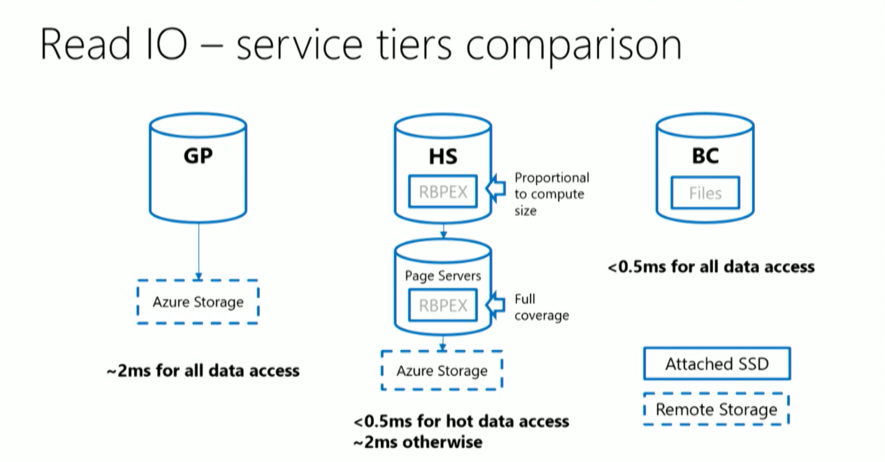

Slide 64
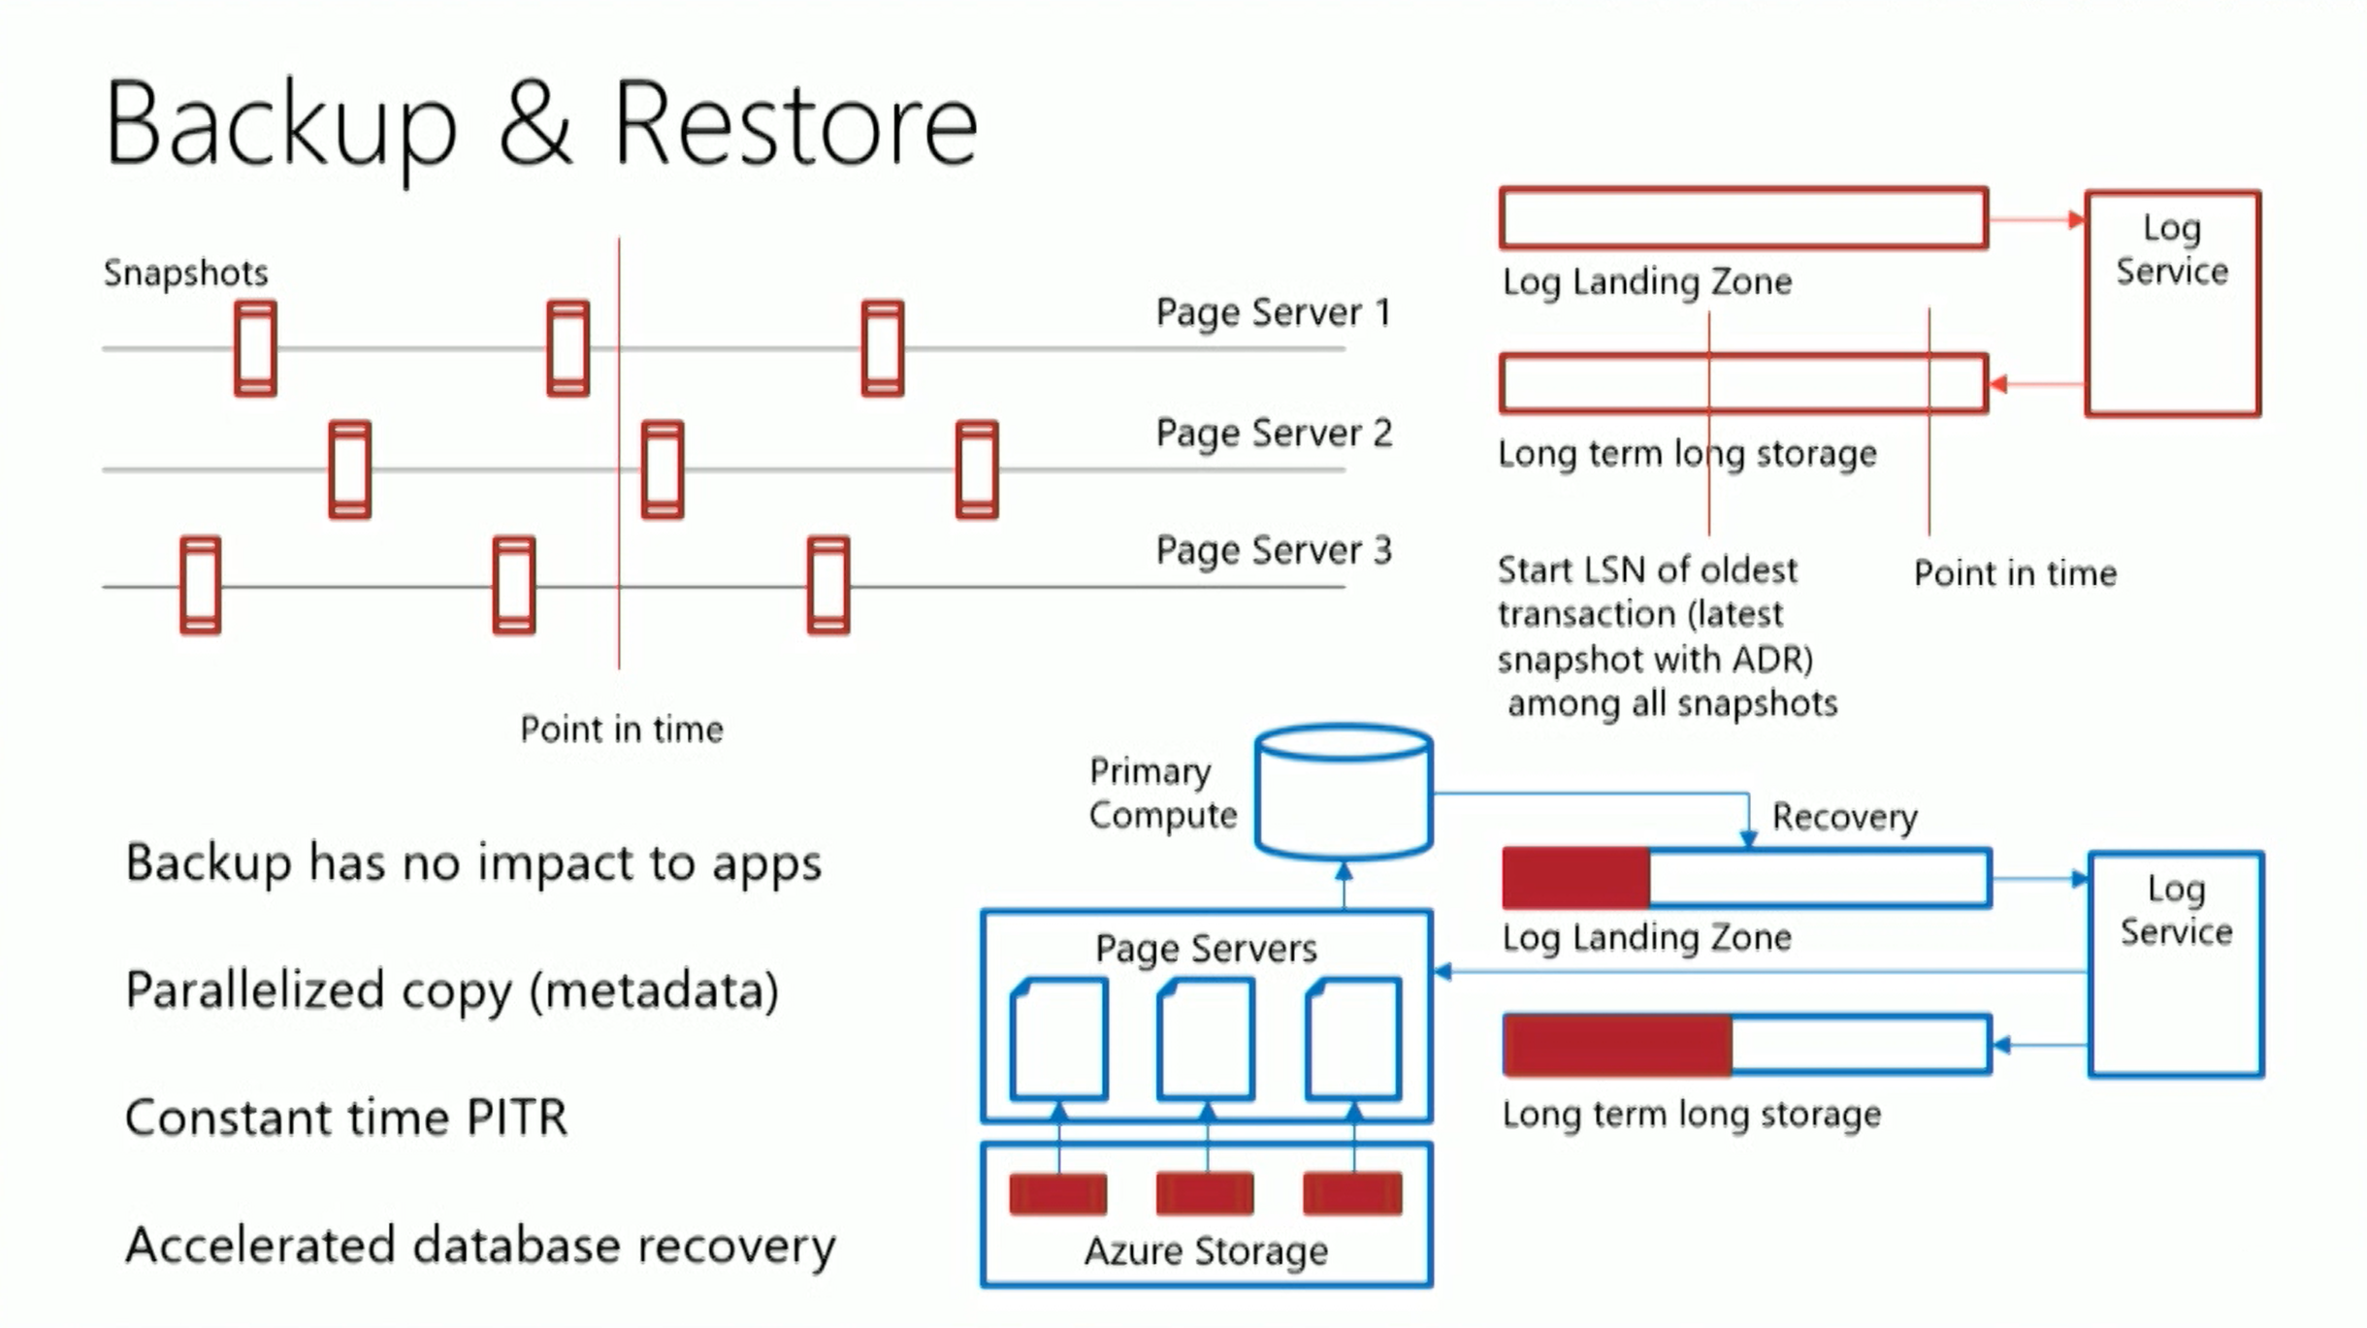

Slide 65


Slide 66
Document | When to use it
What is a Managed Instance (preview)? | High level details about SQL MI – service description and positioning.
Azure SQL Database pricing page | Business model and pricing details.
Azure Hybrid Use Benefit (AHUB) | Discount details for customers with SQL Server licenses
Feature comparison: Azure SQL Database versus SQL Server | High level feature availability matrix and need comparison with SQL Server and rest of SQL Database.
Azure SQL Database Managed Instance T-SQL differences from SQL Server | Detailed functional behavior of SQL MI.
Create Managed Instance - Tutorial | How to create SQL MI and connect to it (quick getting started guide).
How To: Configure a VNet for Azure SQL Database Managed Instance How To: Configure a Custom DNS for Azure SQL Database Managed Instance | How to makes sure that VNet is compliant with SQL MI requirements. Networking misconfiguration is currently the most frequent reason that prevents customers from deploying SQL MI successfully.
Connect your application to Azure SQL Database Managed Instance | High level of detail how to connect app to MI (supported scenarios, high level steps, links on detailed how-to).
SQL Server instance migration to Azure SQL Database Managed Instance | Various options to migrate application to SQL MI.
Azure Support plans | Explore the range of Azure support options and choose the plan that best fits, whether you're a developer just starting your cloud journey or a large organization deploying business-critical, strategic applications.
How to create Azure support request | Step by step instructions to open support ticket

Slide 67
Other Useful references
Ultimate guide for creating and configuring Azure SQL Managed Instance
https://medium.com/azure-sqldb-managed-instance/the-ultimate-guide-for-creating-and-configuring-azure-sql-managed-instance-environment-91ff58c0be01
https://social.technet.microsoft.com/wiki/contents/articles/52410.azure-databases-introduction-to-sql-managed-instances.aspx
Feature Comparison
https://docs.microsoft.com/en-au/azure/sql-database/sql-database-features
Performance Differences
https://azure.microsoft.com/en-us/blog/key-causes-of-performance-differences-between-sql-managed-instance-and-sql-server
Azure SQL Managed Instance network environment
https://blogs.msdn.microsoft.com/sqlserverstorageengine/2018/07/02/deploy-azure-sql-managed-instance-network-environment-using-arm/
Storage layer in General Purpose
https://medium.com/azure-sqldb-managed-instance/file-layout-in-general-purpose-azure-sql-managed-instance-cf21fff9c76c
Migration Considerations
https://blogs.technet.microsoft.com/hybridcloudbp/2018/11/02/migration-from-sql-server-to-azure-sql-database-managed-instance/
SQL backup to Azure Blob Storage cheat sheet:
https://techcommunity.microsoft.com/t5/DataCAT/SQL-Server-Backup-to-URL-a-cheat-sheet/ba-p/346358

Slide 68
SQLBits
Making Managed Instance Perform, a dive into storage
https://sqlbits.com/Sessions/Event18/Introduction_to_Managed_Instances
Managed Instances Deep Dive
https://sqlbits.com/Sessions/Event18/Managed_Instances_Deep_Dive
Hyperscale for Azure SQL DB
https://sqlbits.com/Sessions/Event18/Hyperscale_for_Azure_SQL_DB
Azure Managed Instances—Your Bridge to the Cloud
https://sqlbits.com/Sessions/Event18/Azure_Managed_Instances_Your_Bridge_to_the_Cloud2

Slide 69


Slide 70


